Slide 1
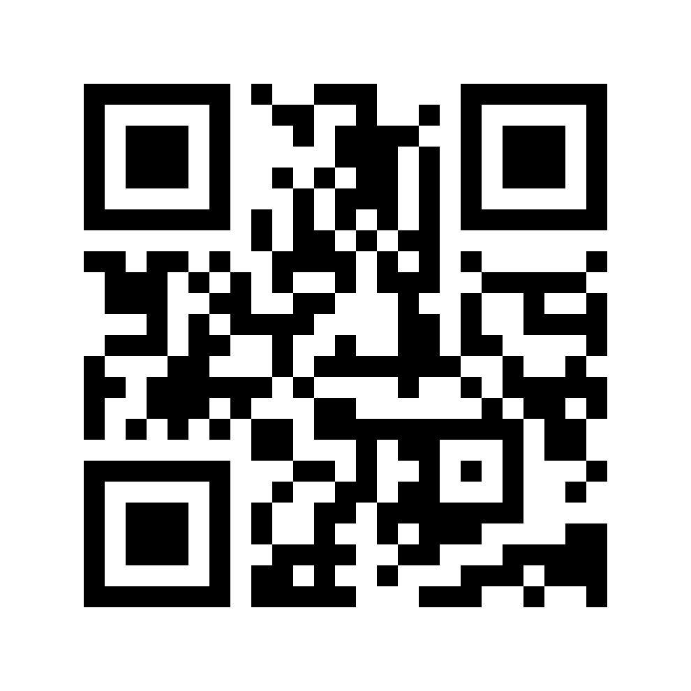

Moving beyond the Digital Uncommons
https://berthub.eu/dc-edic
bert@hubertnet.nl / @bert_hubert@eupolicy.social

Slide 2












https://opentk.nl/
(advisor)
Notes:
Nou ik heb echt vanalles gedaan - PowerDNS is software waar in Nederland nog steeds >50% van het internet doorheen gaat. Ik heb ook de overheid goed van binnen gezien, en ben er ook toezichthouder geweest.

Slide 3
All of society now runs on computers
(not ours)
IT is more important than ever. And the world is also far scarier today
Governments have a leading role in improving things
(industry is not going to do it)

Slide 4
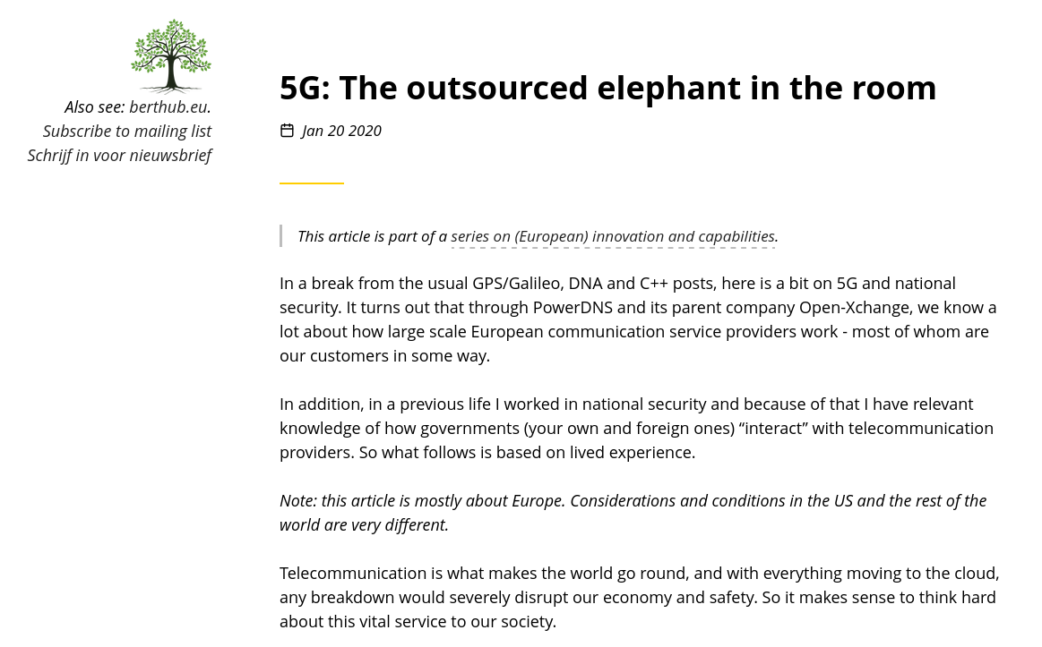

Slide 5
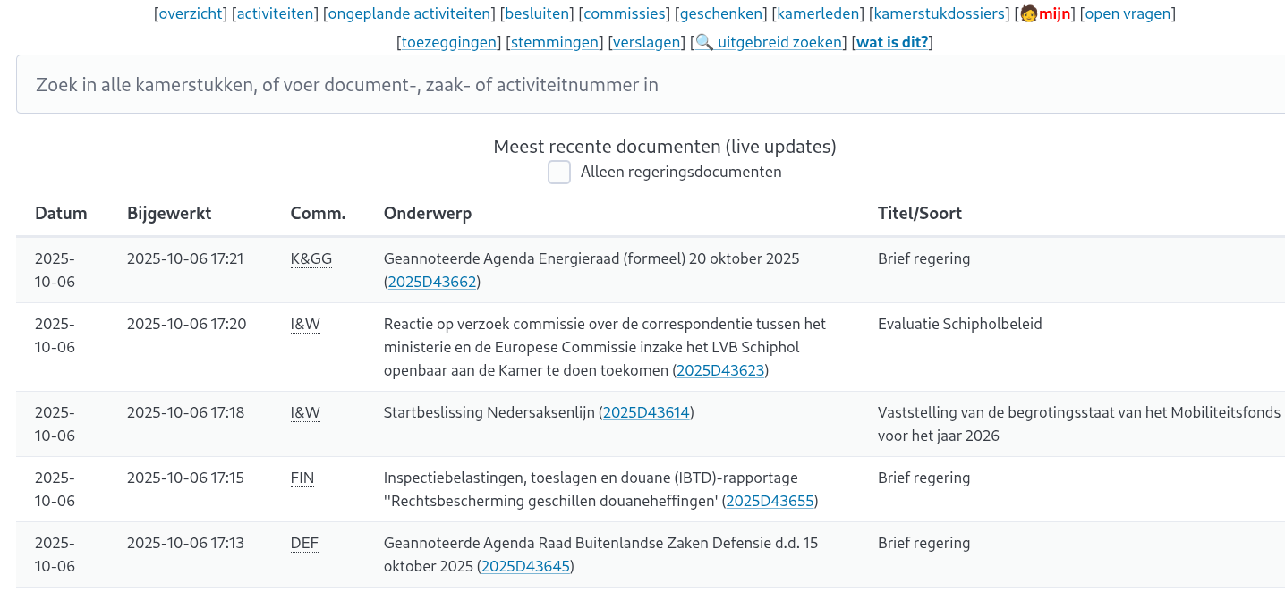
opentk.nl

Slide 6
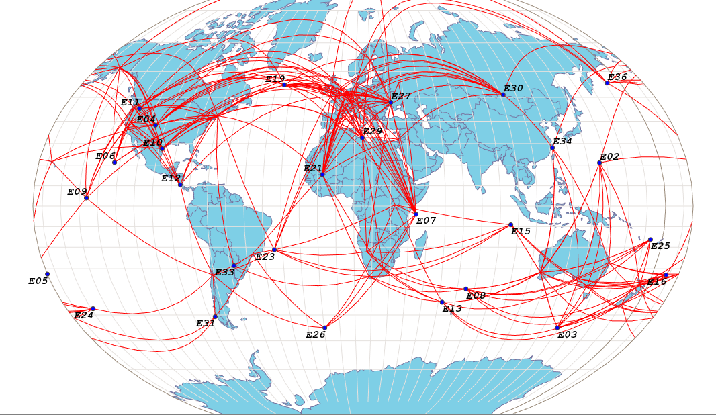


https://galmon.eu/

Slide 7

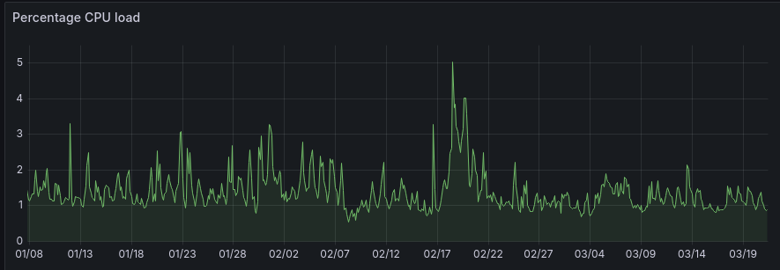
Bare metal, 64 GB RAM, 1TB SSD
Intel(R) Core(TM) i5-10500T CPU 6 cores
“500 euro/year”
<35W
Galmon.eu, opentk.nl, berthub.eu/nlelec, BAG conv
Notes:
Behold, the server that powers _all_ of this

Slide 8
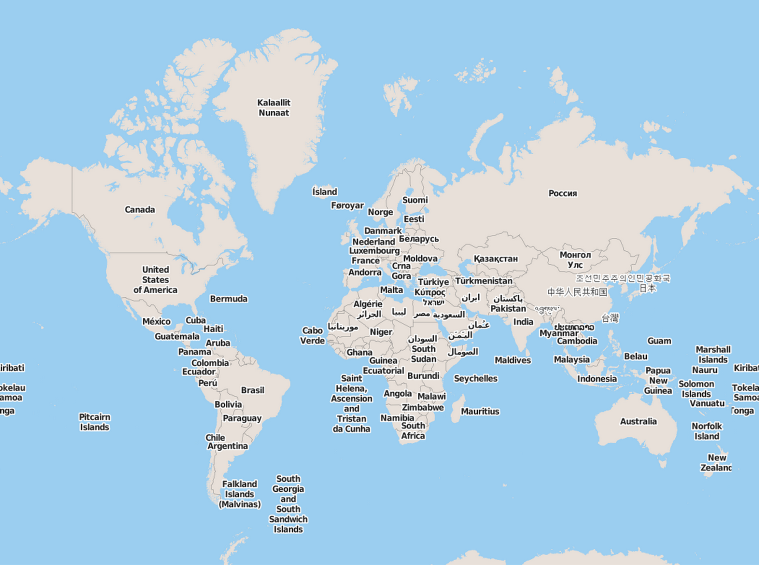







Notes:
Ja dit is niet best, alle clouds komen dus van buiten Europa. Tot nu toe hebben mensen wel door dat je je overheid of andere belangrijke processen niet op de Alibaba Cloud moet draaien, maar dat komt vermoedelijk niet omdat mensen nadenken over de ‘soevereiniteit’. Het lijkt erop dat Europa z’n overheden nog op Noord Koreaanse servers zou draaien als de gebruikersinterface een beetje aantrekkelijk was.

Slide 9






Slide 10






“That cloud and AI of yours come out of our machines exclusively”

Slide 11











Notes:
De Europese en Amerikaanse cloudproviders. Niet echt op schaal, maar het schetst een beeld. Kijk goed onder de ‘e’ van Google. OCI is Oracle

Slide 12


Notes:
Een beetje willekeurige selectie van Europese providers van beperkte clouddiensten. Met een focus op voor Nederland relevante partijen. Maar de schaal is wel even iets anders.

Slide 13
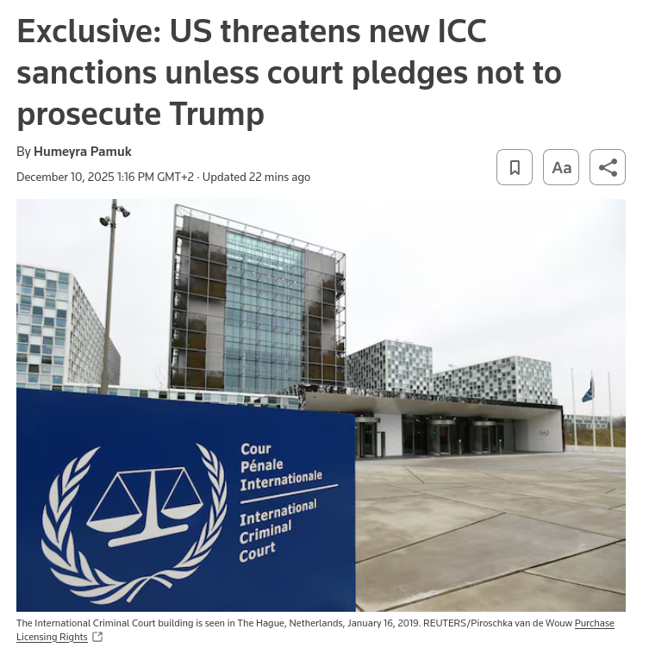
Notes:
https://www.reuters.com/world/us/us-threatens-new-icc-sanctions-unless-court-pledges-not-prosecute-trump-2025-12-10/

Slide 14
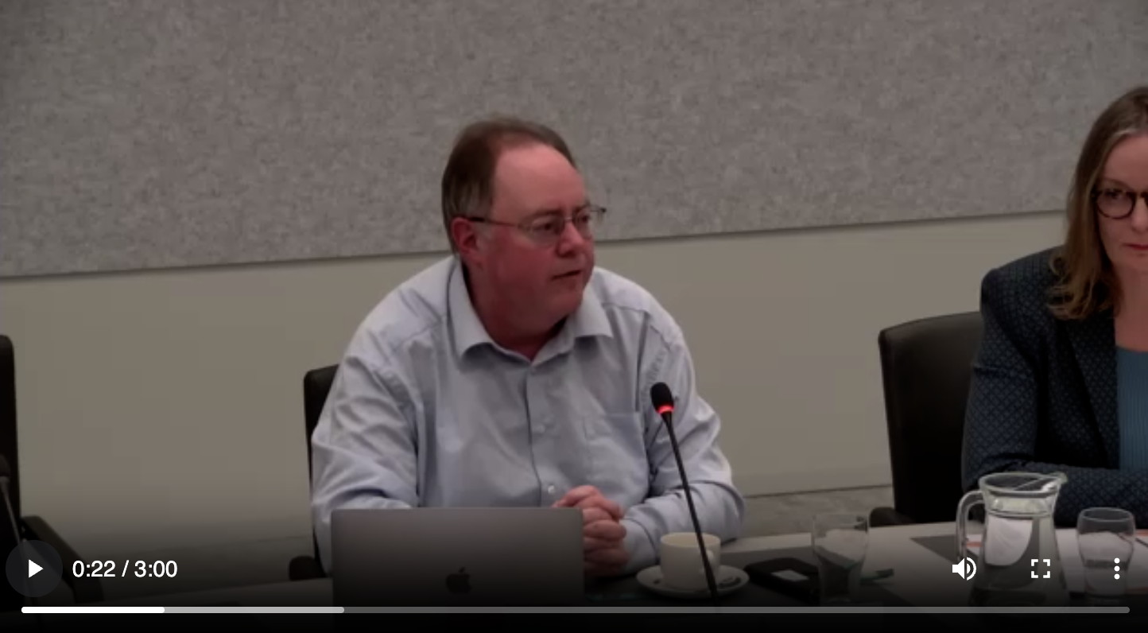

Slide 15
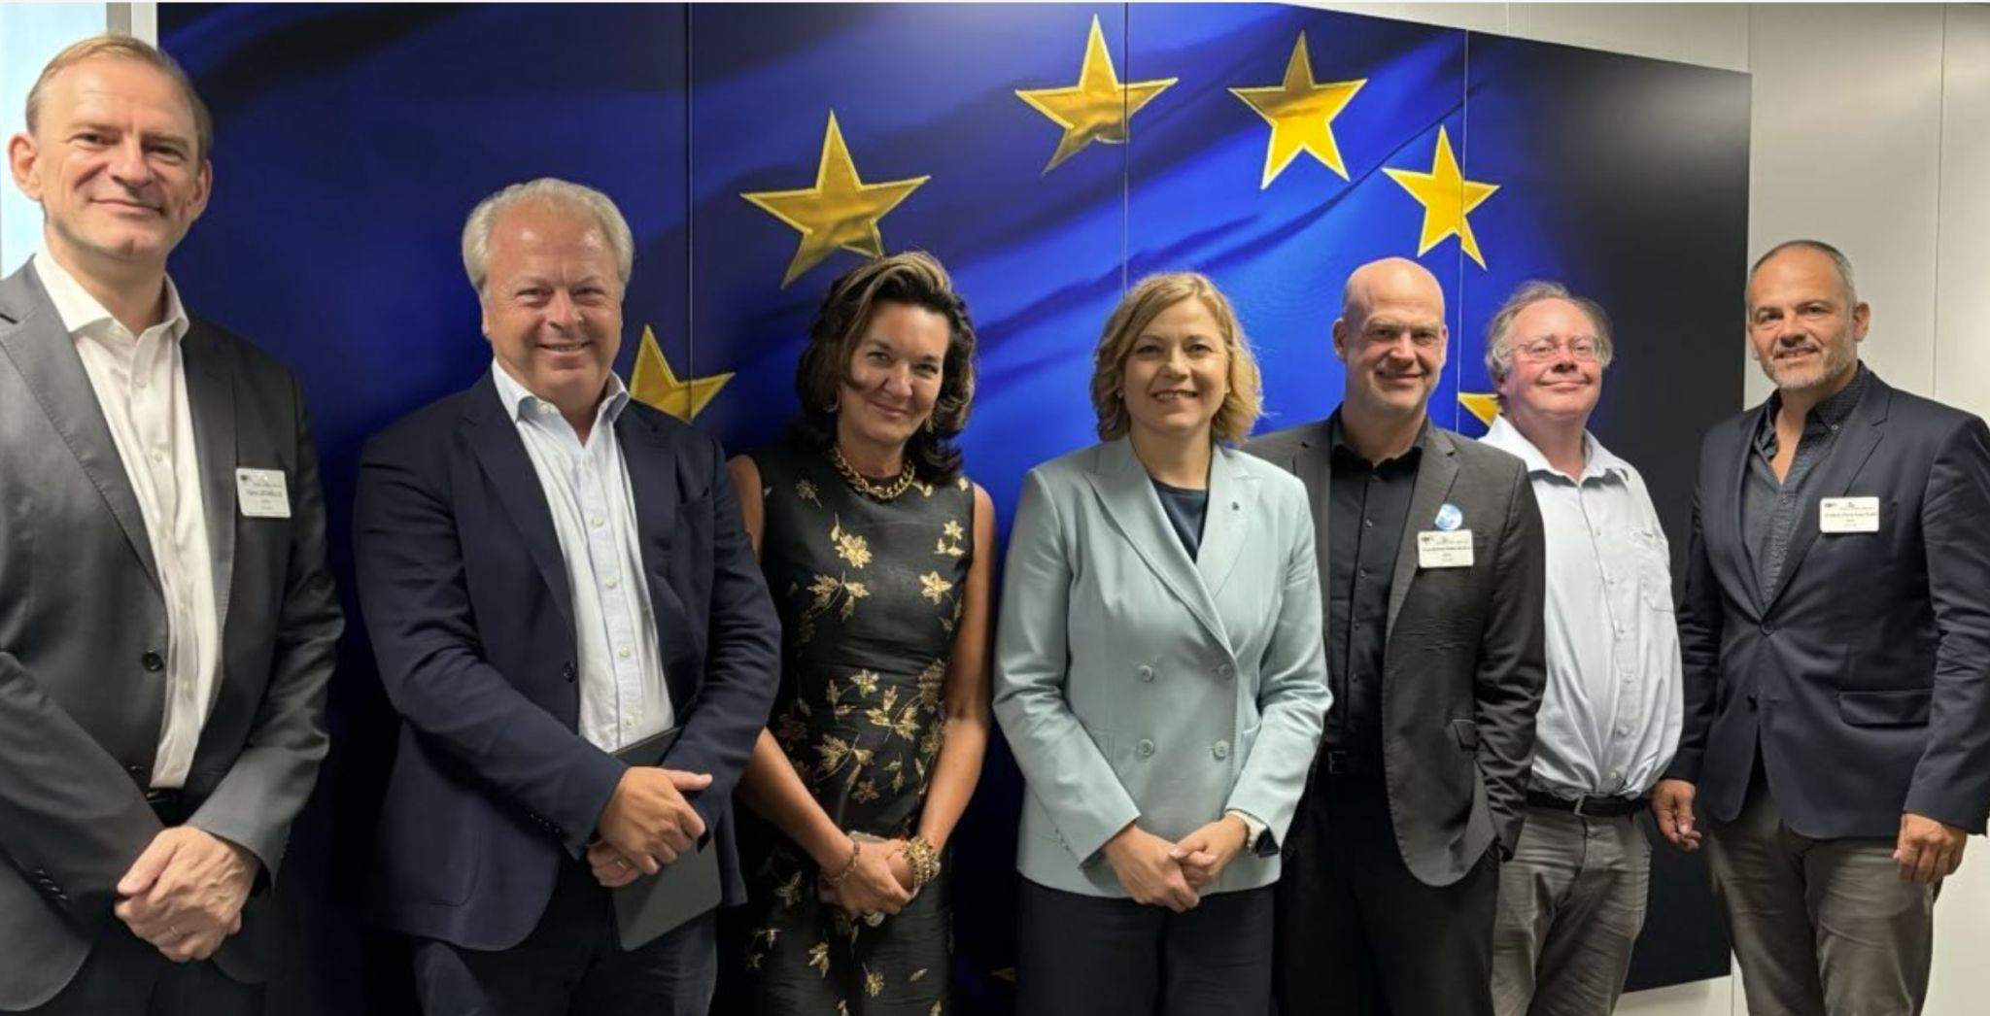

Slide 16
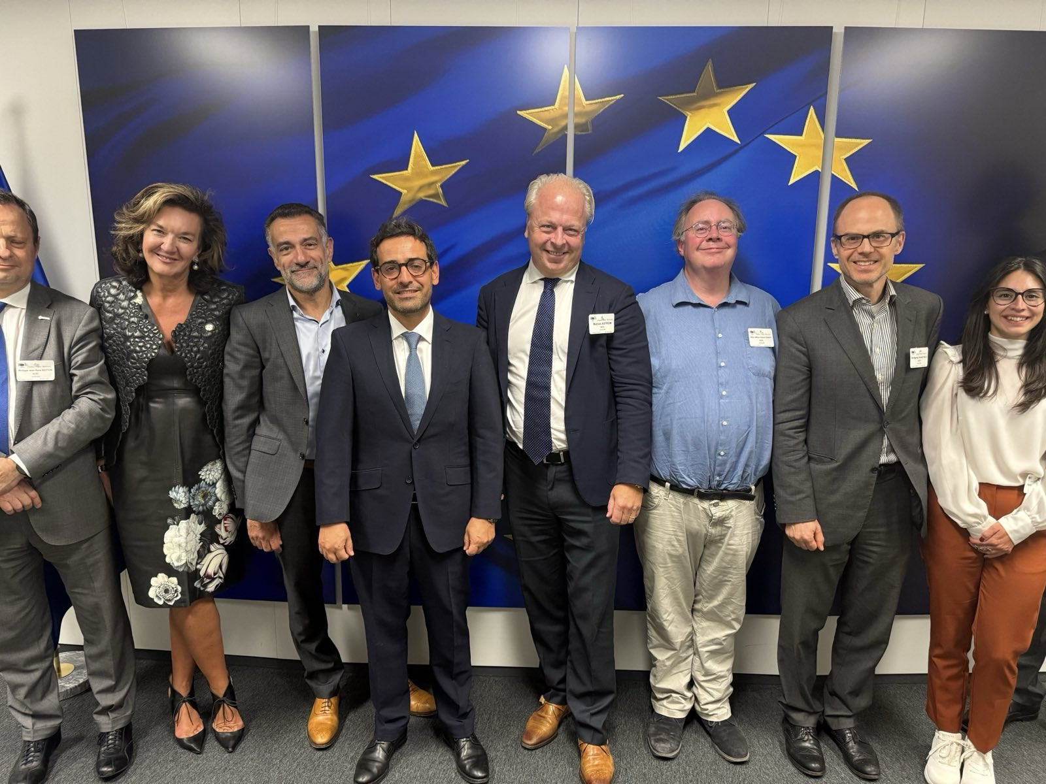

Slide 17

King

Slide 18

Notes:
Ber Huber de Tech Exper, https://www.youtube.com/watch?v=uoTMwX_clDs

Slide 19

Digital Commons European Digital Infrastructure Consortium

Slide 20
Digital Autonomy
Digital Commons
Digital Commons will always enable you to have Digital Autonomy.
But the other way around is not necessarily the case.
This makes Digital Commons even more important!

Slide 21
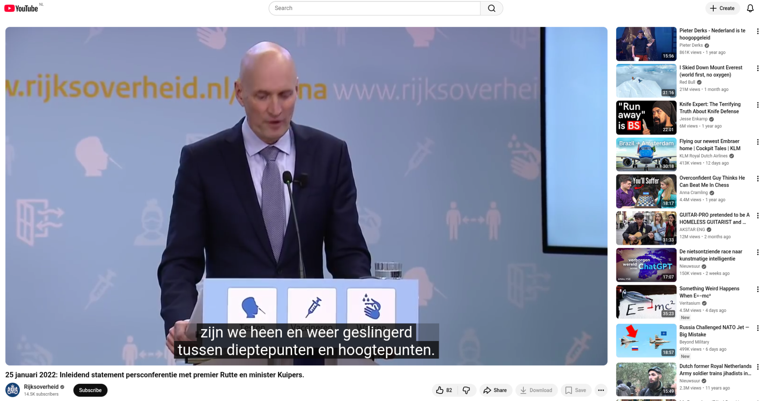

Slide 22

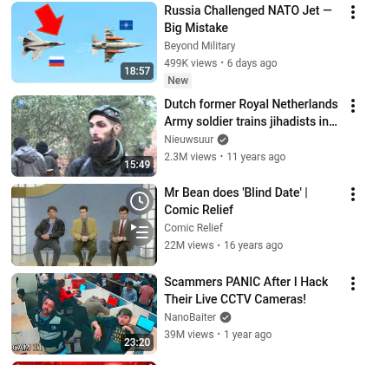

Slide 23
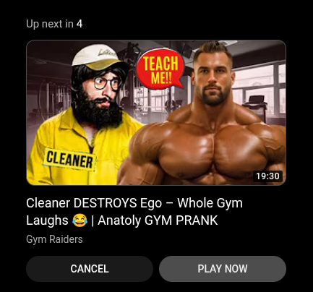

Slide 24

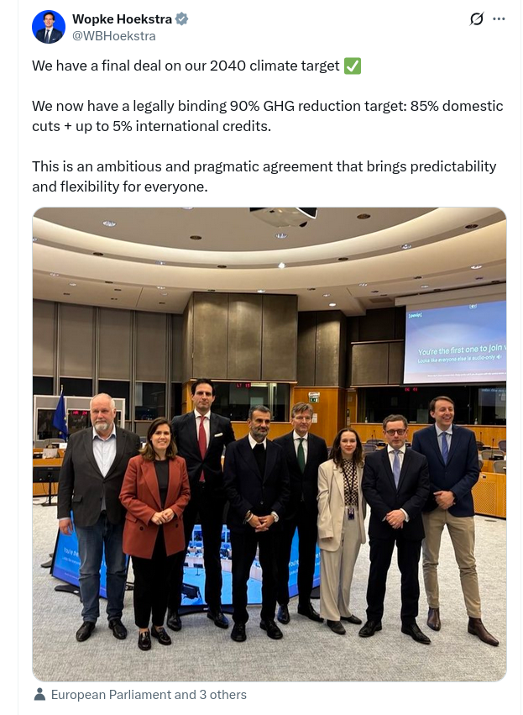


Slide 25
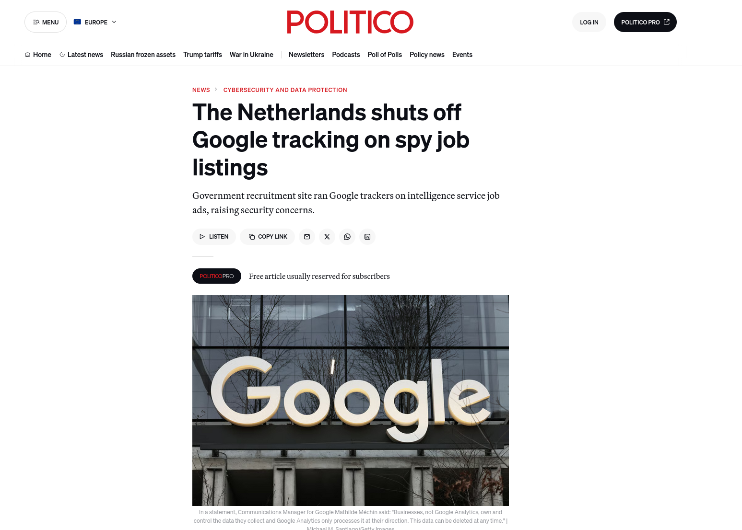
This took three years

Slide 26
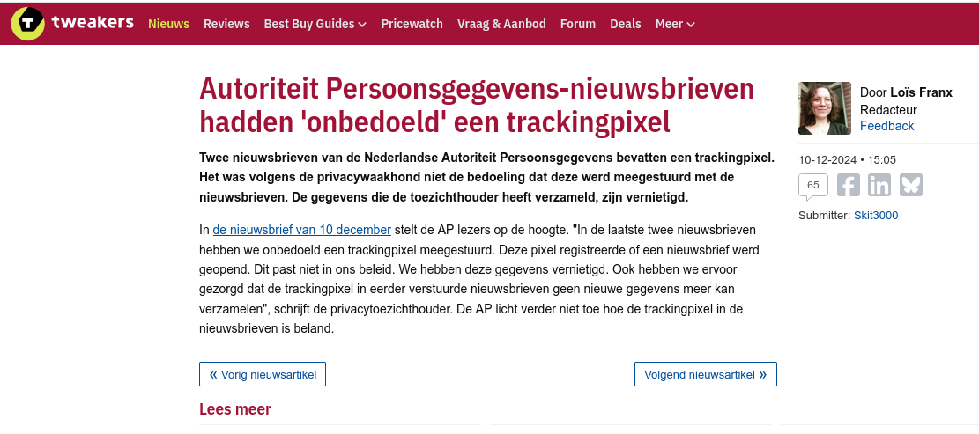
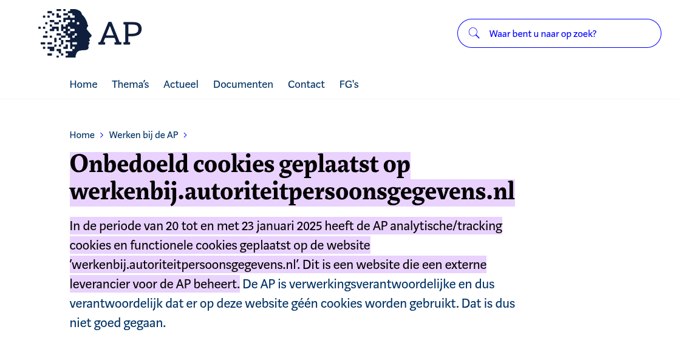
“Neither Google or Vimeo/Cloudflare responded to our reminder of the 15th of May 2025.”
Even the well meaning people over at the Dutch Data Privacy Authority have a very hard time doing the right thing.

Slide 27
Our most basic functions are now so Digitally Uncommon that we have very little effective control over what is going on!
Why do we need big tech to talk to our citizens?
Why do we allow them to hijack our interactions?
These basic things should be Digital Commons, with tremendous transparency & control

Slide 28
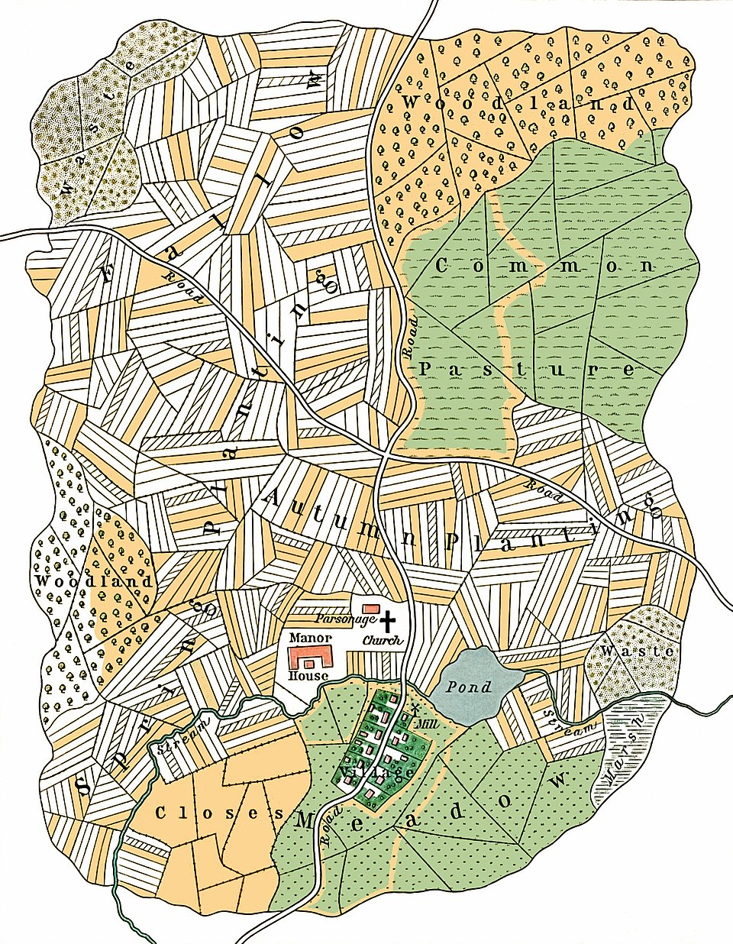
Wikipedia
OpenStreetMap
C, C++, Rust, Python
PostgreSQL, SQLite (*), Linux
PeerTube
Mastodon
Formerly email
We are losing the web
Notes:
https://en.wikipedia.org/wiki/Common_land

Slide 29


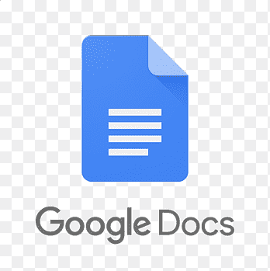

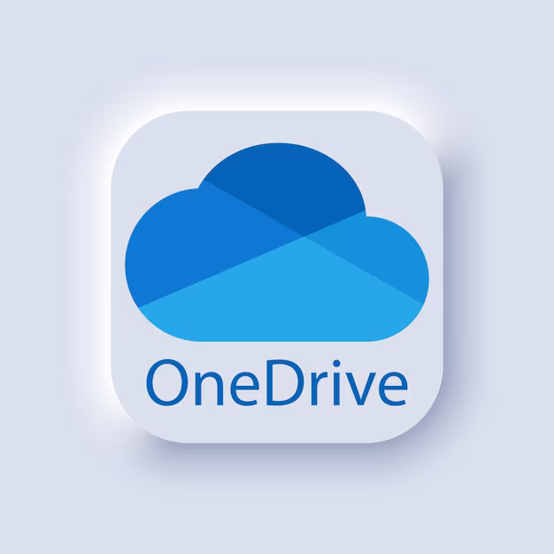


Perceived, but false digital commons
And we must address these all!
Notes:
Ignore these at your peril!

Slide 30
Email as a (former) digital commons
Open standards!
Many open source implementations!
No need to join any structure or entity to take part!
2025 reality: less than 95% of your email arrives, unless you are a customer of Microsoft, Google, Apple or Amazon
Big players randomly block non-big player email
  No recourse
  No appeal
  No communication even
  They blame you, and ridicule you for not sticking to their secret rules
Effectively, email is now a walled garden
  Unless you can stand to sometimes not be able to email
  Or are ok with losing 5% of your messages

Slide 31
For successful Digital Commons use:
Open technology / standards (🤩)
Open implementations (😊)
No gatekeepers, or gatekeepers with open governance
(Also) provided as a service, or with integrator (😕)
With actual marketing and sales (😬)
Good without excuses (😡)

Slide 32
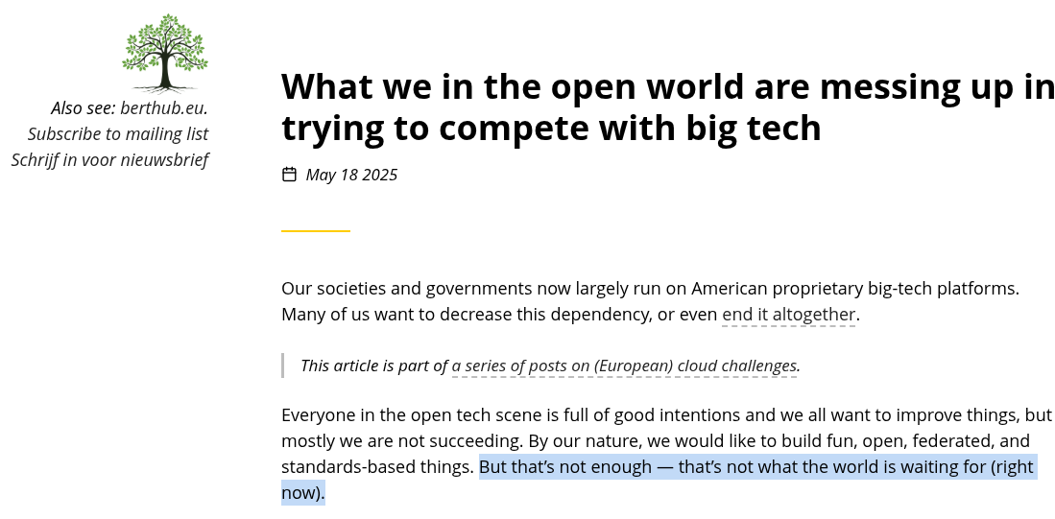
At the first “your stuff is weird, why is it like this,” you’ve lost almost everyone. You get no credit just because your solution is European or Open Source or both. Quite the opposite. Your stuff has to be more beautiful and easier to use than what Microsoft and Google offer
Notes:
https://berthub.eu/articles/posts/what-the-open-world-must-do-better/

Slide 33



I love all these projects
Open standards
Open software
Governance
As a service
Marketing/Sales
“Smooth, no excuses”
✅ ✅ ✅ ✅
✅ ✅ ✅ ✅
✅ ✅ ✅ ✅
✅ ? 😕 X
😕 ? X X>✅
X ✅ X

Slide 34
What to do?
Building a European community of public, private and civic stakeholders
Facilitating access to funding, including via a physical and online one-stop-shop and expertise hub
Offering legal and technical support for maintenance and scaling
Providing policy advice and awareness-raising
Coordinating and participating in concrete multi-country projects anchored in digital commons
Hand out an award!
I have a few recommendations

Slide 35
Governments very much DO NOT like to be the first to do something
  Find champions in use of OpenStreetmap, PeerTube, BigBlueButton/Jitsi, Mastodon etc and promote their good work
  Norm setting: DC-EDIC should be a living example of Digital Commons!
Current Digital Commons community very idealistic (as they should be)
  Educate them on what governments also need (which is not a free Mastodon server) and how users should not experience barriers
Protect/rebuild the email digital commons by bundling delivery complaints to Digital Uncommons emailproviders, and providing publicity
Educate governments to at least ALSO share their stuff on open platforms (no need to rip out everything first!)

Slide 36
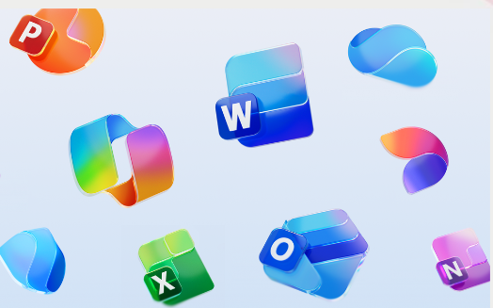
"If you come at the king, you best not miss"
People, rightfully, hate any kind of IT change. You need to be a huge success to ram this through!
Notes:
https://digital-strategy.ec.europa.eu/en/news/commission-launch-digital-commons-edic-support-sovereign-european-digital-infrastructure-and

Slide 37
Digital Commons are a bigger goal than Digital Autonomy, but they also get you Digital Autonomy
Currently almost everything is Digital Uncommons
  Including government communications & email
There are great Digital Commons out there already, and the standards & software are pretty good
  However for DC success we need more
DC-EDIC is in a great place to address those gaps & spin up the adoption & improvement process, plus educate government & industry
Ponder addressing issues that are within reach first, and take over the world after that
GOOD LUCK!

Slide 38
Moving beyond the Digital Uncommons
https://berthub.eu/dc-edic
bert@hubertnet.nl / @bert_hubert@eupolicy.social

