Slide 1
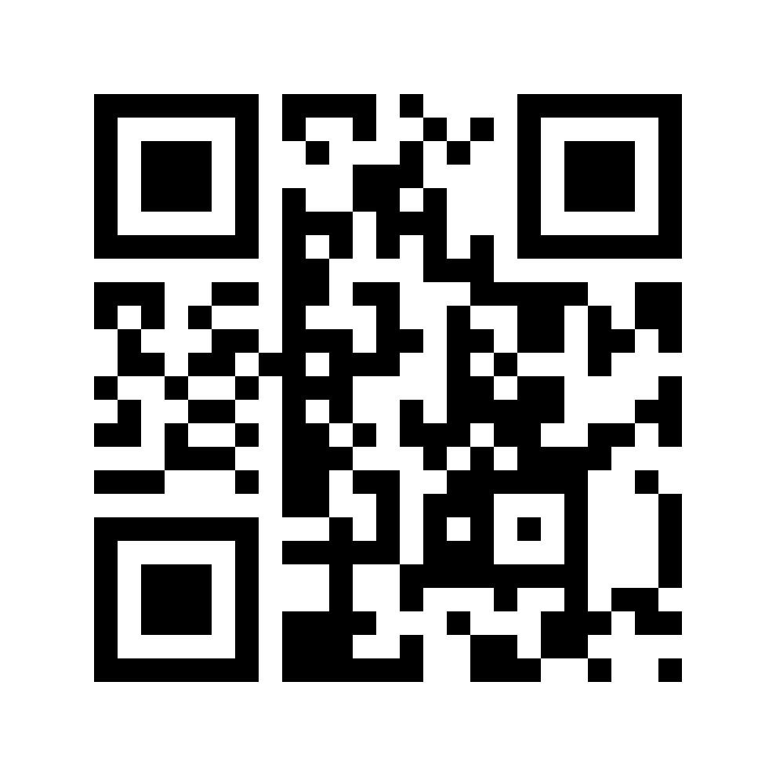
Sovereignty & global surveillance
https://berthub.eu/dis

Slide 2





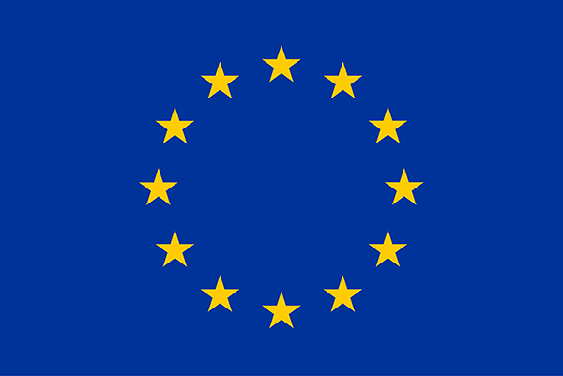






(advisor)
Bert Hubert / bert@hubertnet.nl / +31622440095
Notes:
I have worked for government, been a government buyer, a government supplier and a government regulator, current advisor. But I do not speak for the Dutch government!

Slide 3
Notes:
I was part of the panel that ruled on lawful intercept/hacking for the Dutch intelligence/security agencies.

Slide 4




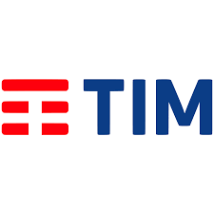

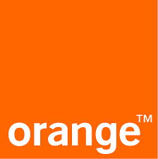

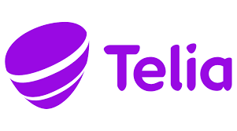



1999 - 2020

Slide 5
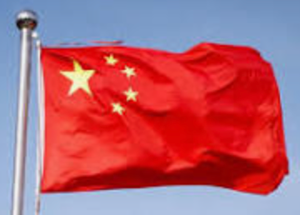
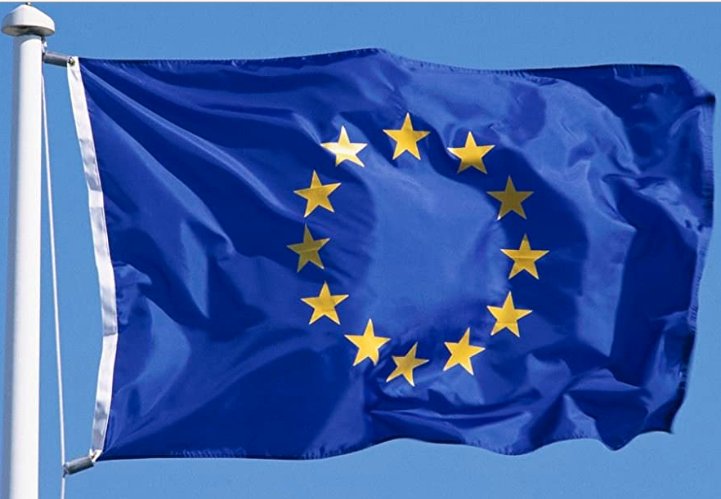
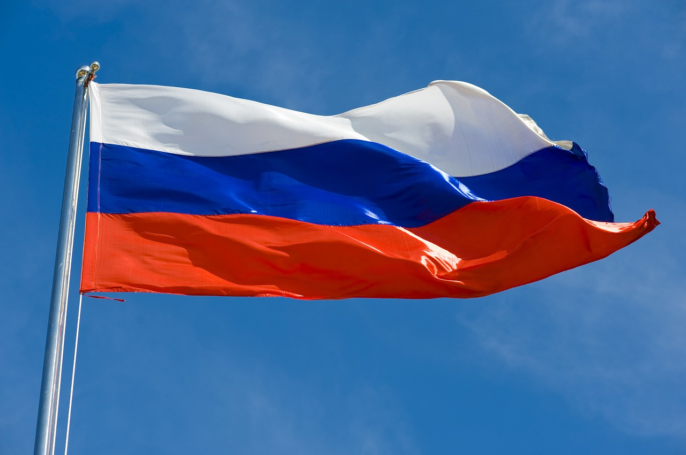
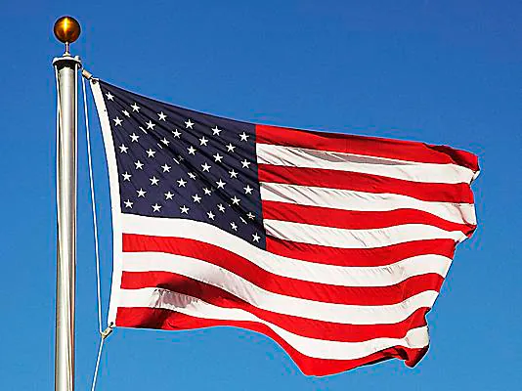




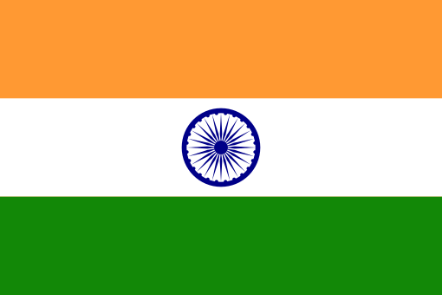



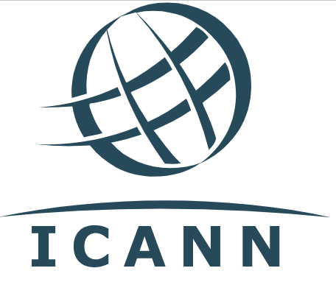


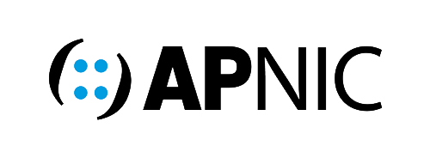


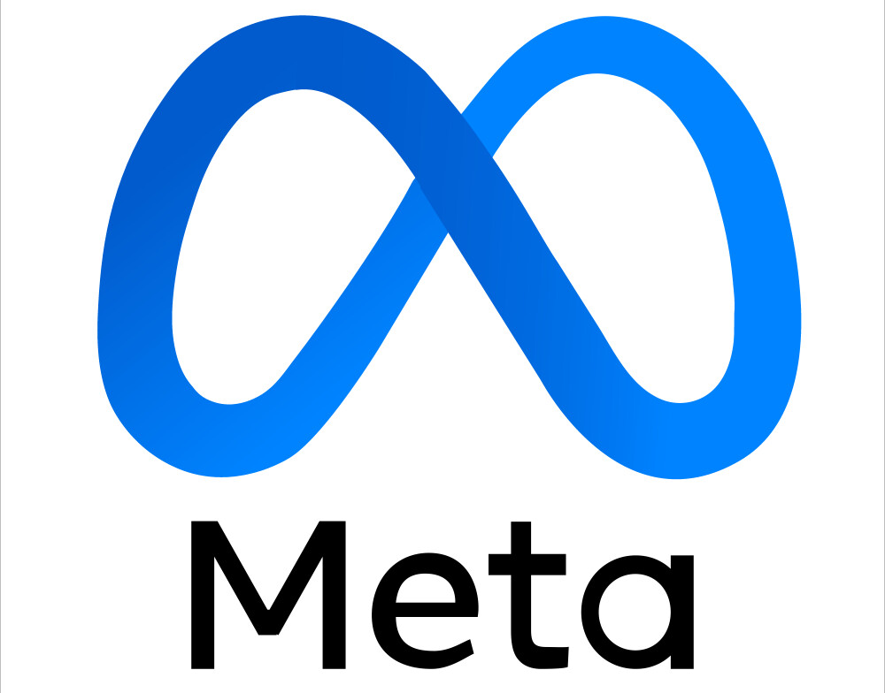

Who controls the internet?

Slide 6
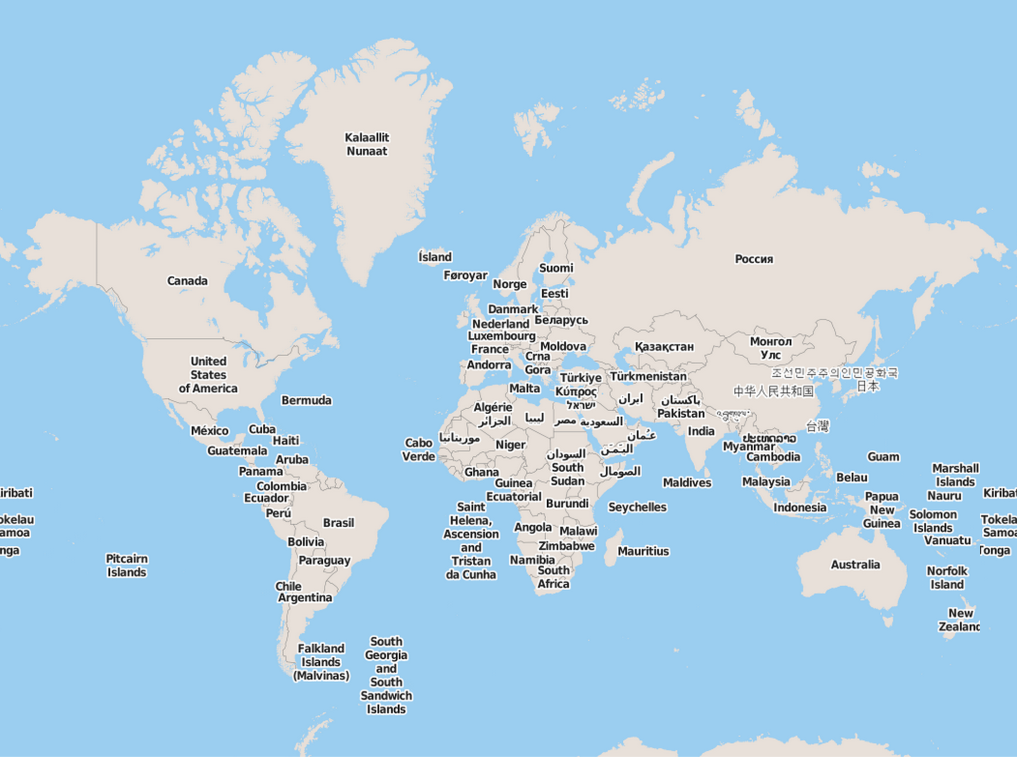

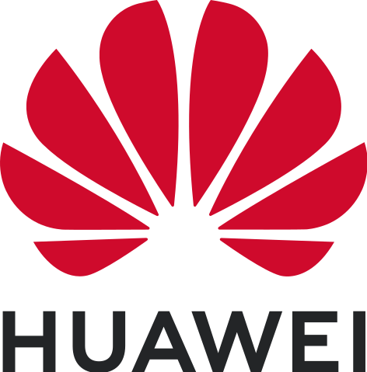

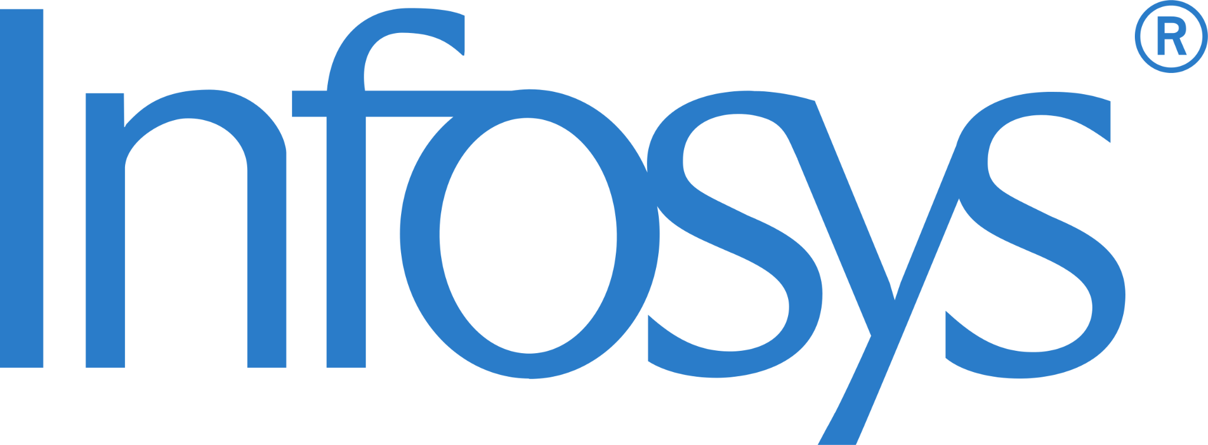


Notes:
Ja dit is niet best, alle clouds komen dus van buiten Europa. Tot nu toe hebben mensen wel door dat je je overheid of andere belangrijke processen niet op de Alibaba Cloud moet draaien, maar dat komt vermoedelijk niet omdat mensen nadenken over de ‘soevereiniteit’. Het lijkt erop dat Europa z’n overheden nog op Noord Koreaanse servers zou draaien als de gebruikersinterface een beetje aantrekkelijk was.

Slide 7


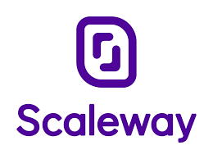







Notes:
De Europese en Amerikaanse cloudproviders. Niet echt op schaal, maar het schetst een beeld. Kijk goed onder de ‘e’ van Google. OCI is Oracle

Slide 8


1:100
Notes:
100 times smaller

Slide 9


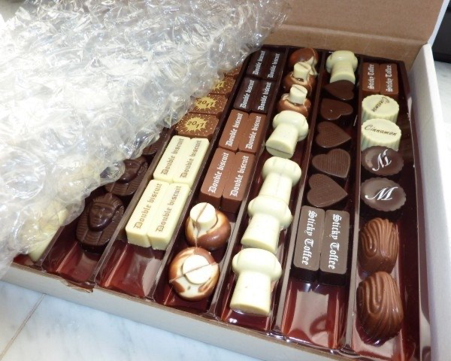


Notes:
At least we still have this going for us!

Slide 10

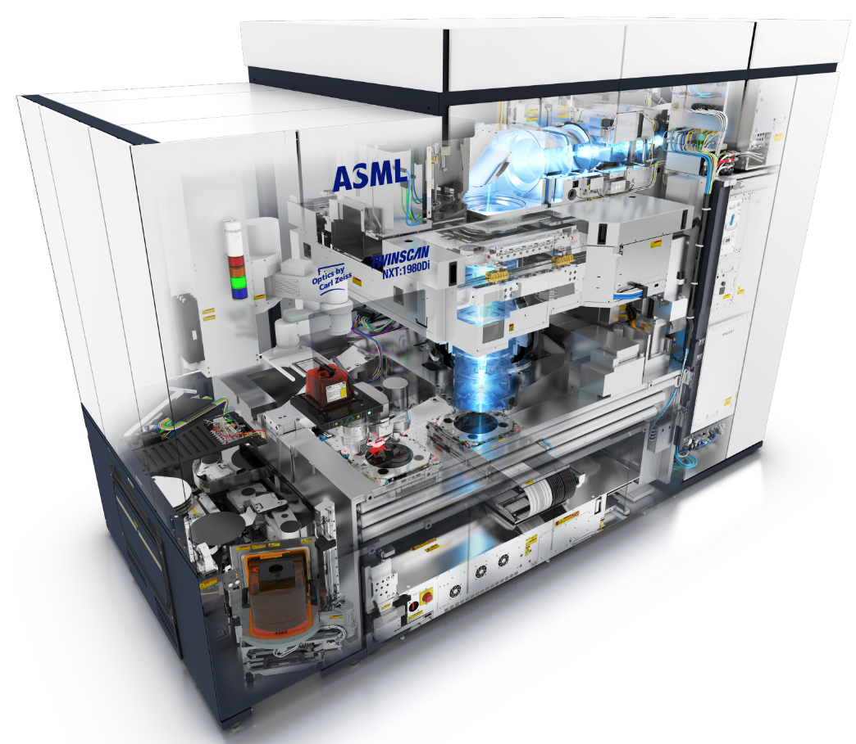
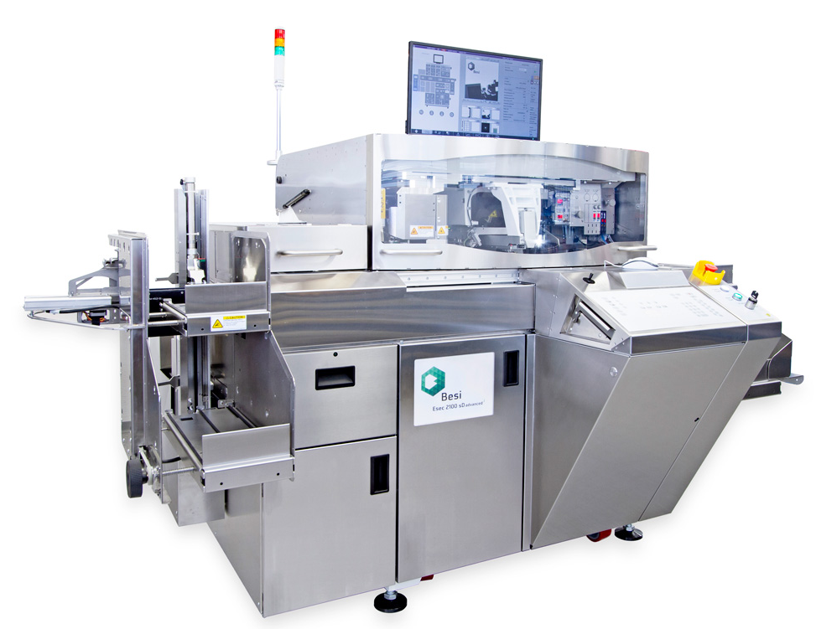



“That cloud and AI of yours come out of our machines exclusively”
Notes:
Nice.

Slide 11
Then senior scientist at the US NSA Bob Morris on how to decrypt data:
"First look for cleartext. You'll usually find it."
Notes:
https://federate.social/@mattblaze/115339234462315512

Slide 12
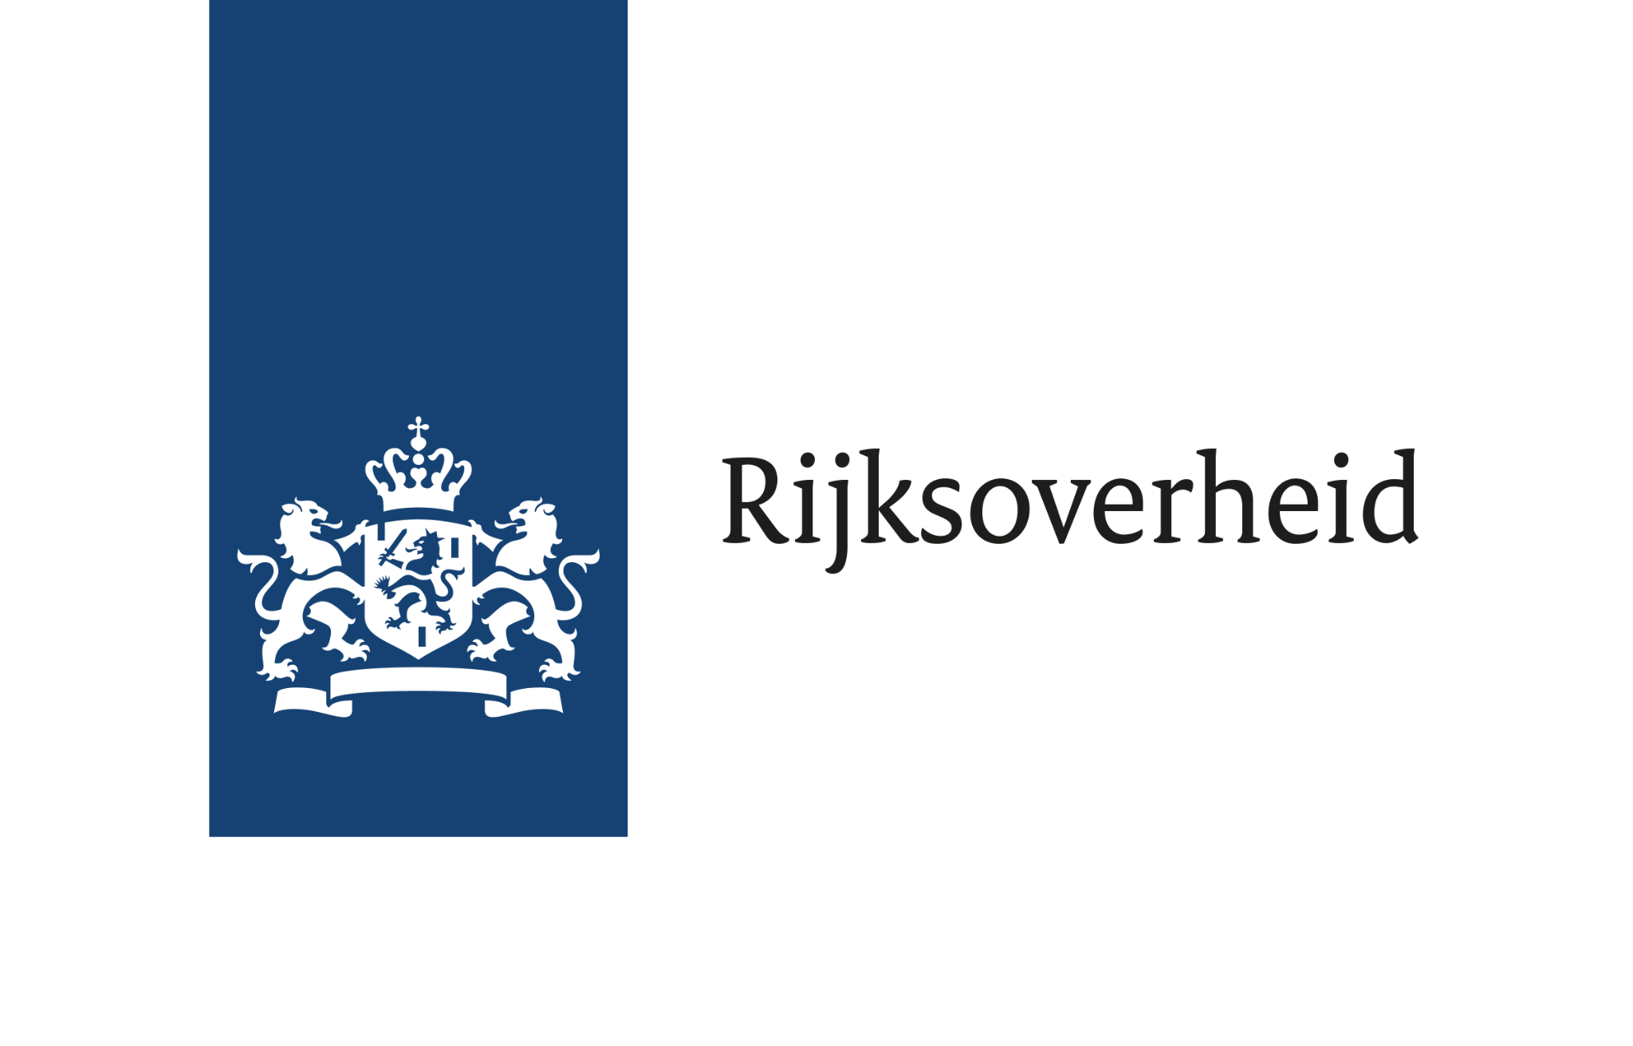

2025-2029
Some ministries
100,00% of all municipalities, banks, notaries public, law firms

Slide 13

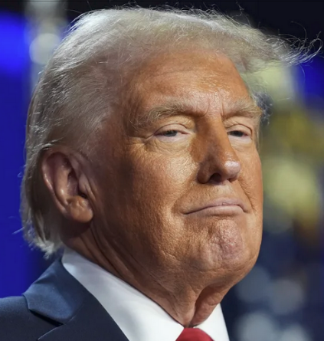
:-(
BTW/VAT!
Notes:
That gets you this

Slide 14
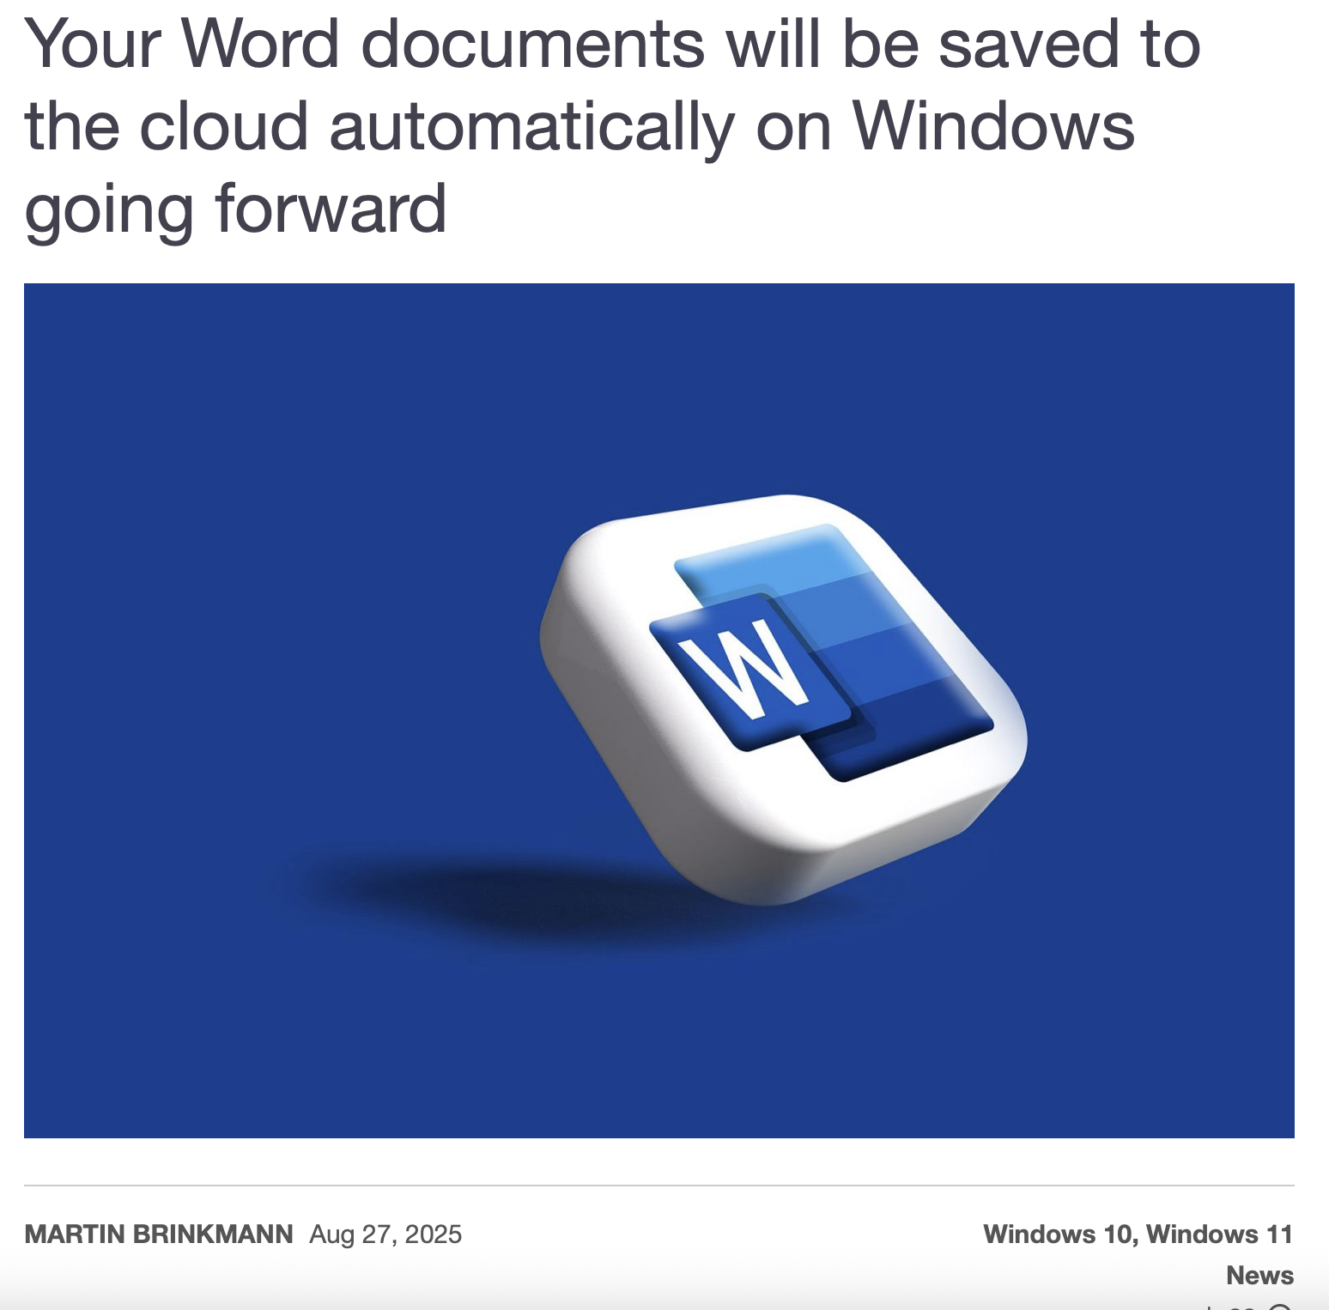
This really is weird
Lawfirms have to host their lawsuits against Microsoft on Microsoft servers
Governments make policy on US, on US servers
A whole continent that is unable to store its own data
Notes:
https://www.ghacks.net/2025/08/27/your-word-documents-will-be-saved-to-the-cloud-automatically-on-windows-going-forward/

Slide 15

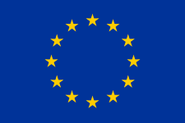
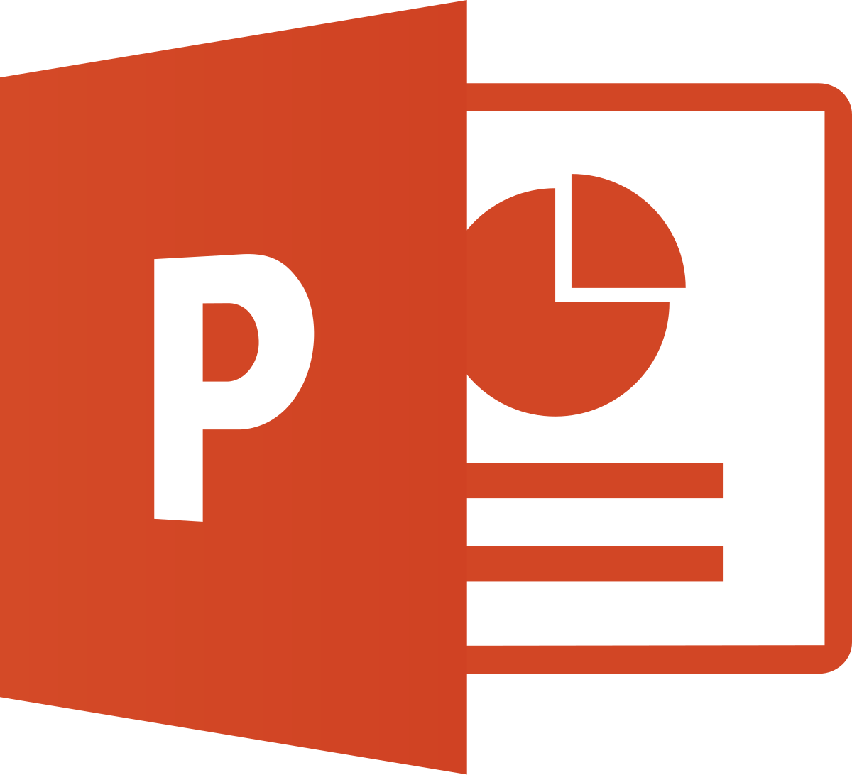

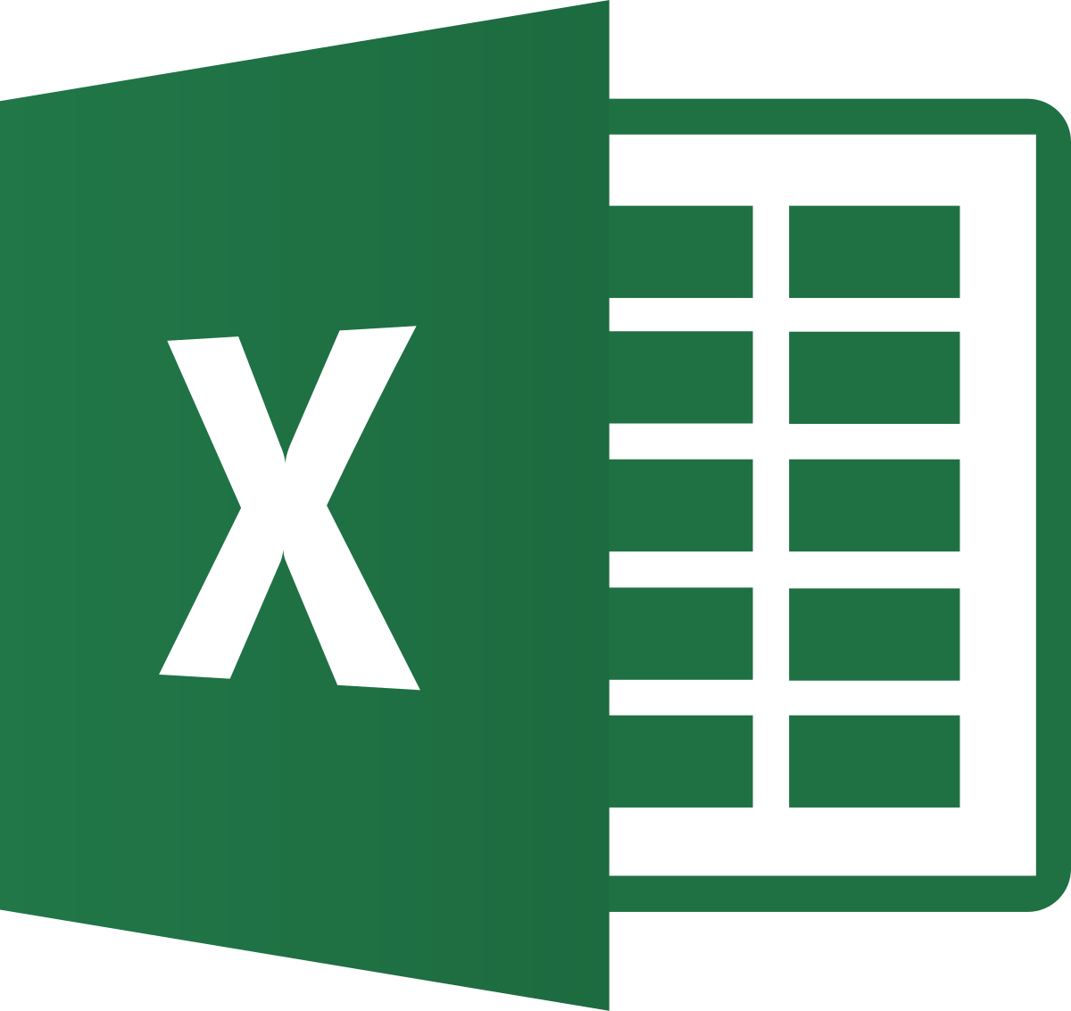
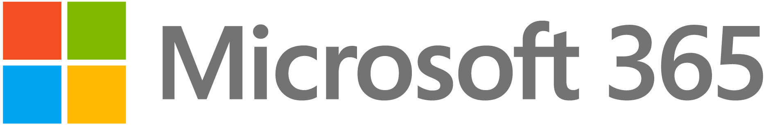




OneDrive
Notes:
It is what it is.

Slide 16
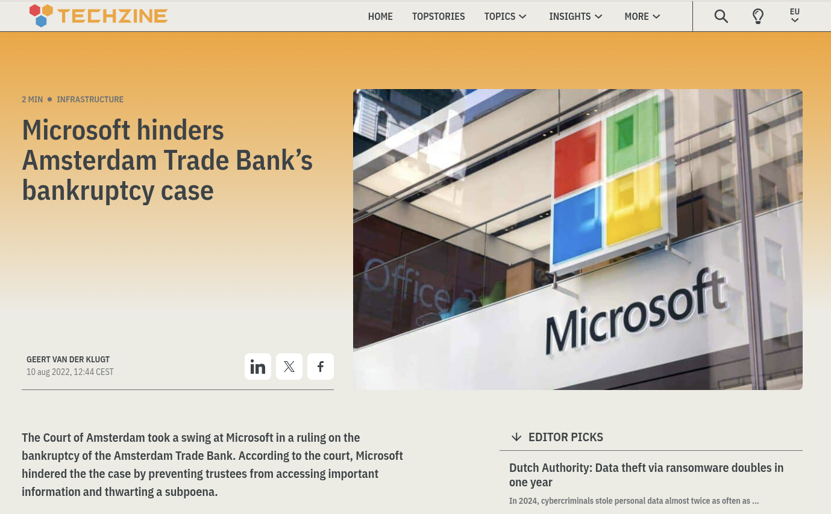

Slide 17
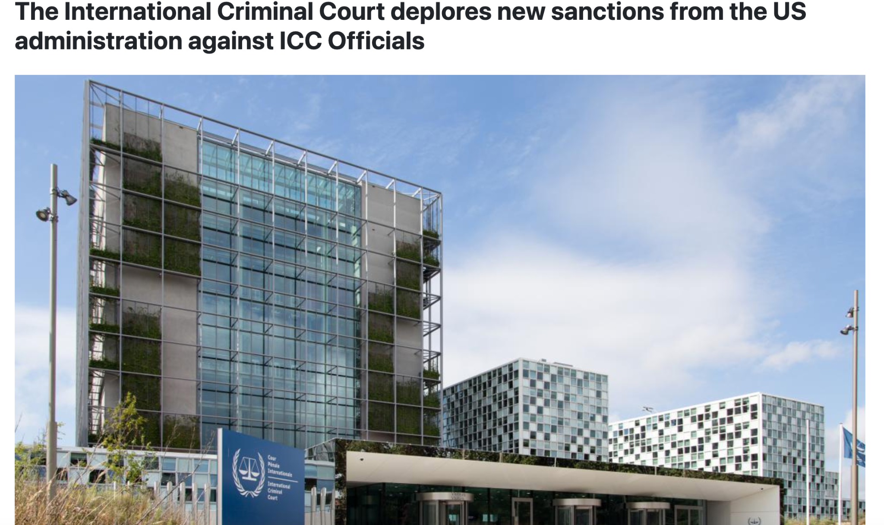

Slide 18
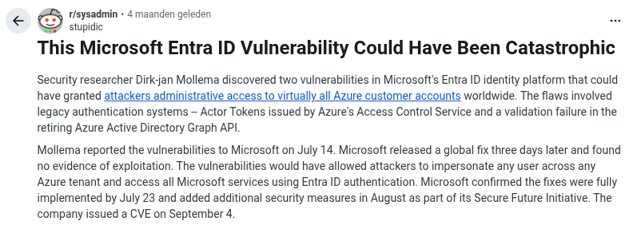

Slide 19


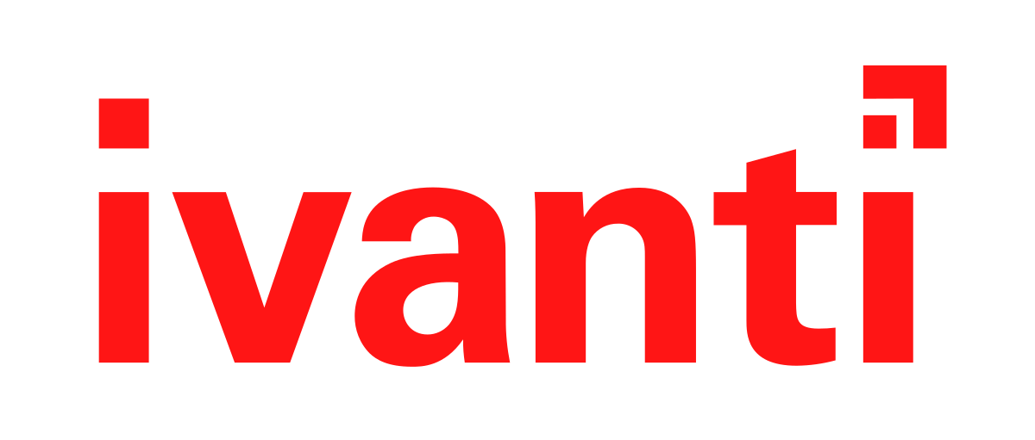



https://cert.europa.eu/publications/security-advisories/2025
Notes:
https://doublepulsar.com/citrix-forgot-to-tell-you-cve-2025-6543-has-been-used-as-a-zero-day-since-may-2025-d76574e2dd2c

Slide 20
This is all UNACCEPTABLE.
Literally a risk that can not be “accepted” © NCSC Webinar, 2026-03-30

Slide 21
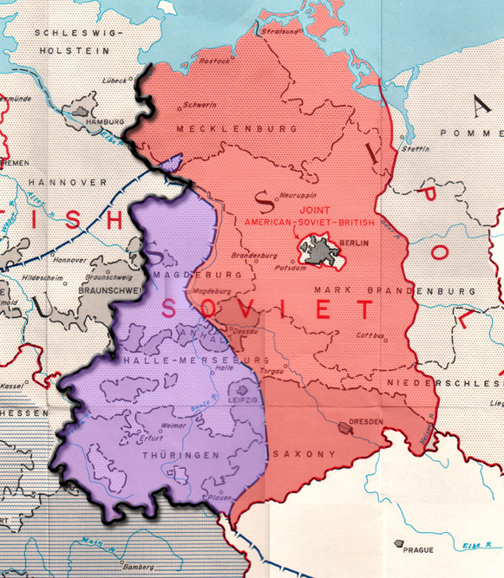

Encryption that was strong… but not TOO strong
Notes:
Berlin was surrounded by the enemy. “The West” wanted secure phones, secure enough so the soviets could not listen in to Berlin. But the west also wanted to be able to break in when needed. They succeeded.

Slide 22
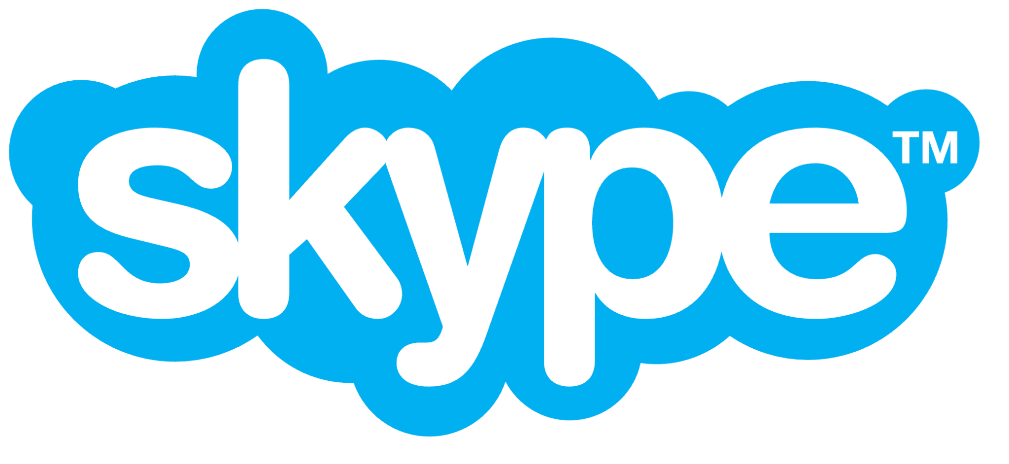
“Skype was created by Niklas Zennström, Janus Friis, and four Estonian developers, and first released in August 2003. In September 2005, eBay acquired it for $2.6 billion”
Notes:
One of the weirdest acquisitions ever

Slide 23
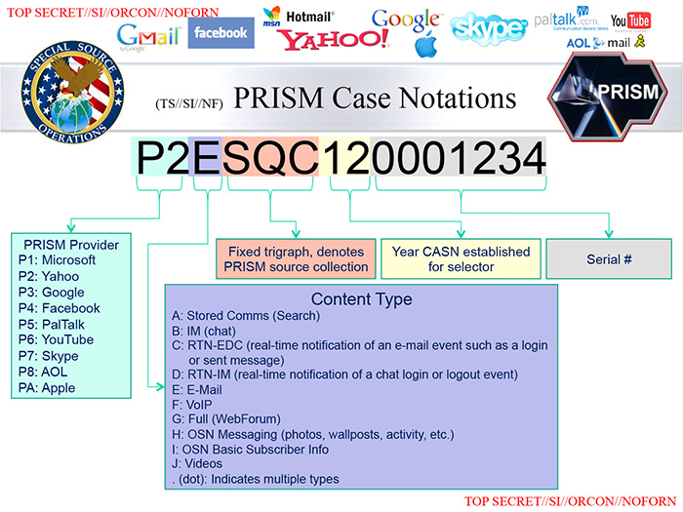
Notes:
Edward Snowden leaks showing Skype participating in the NSA spying program (2011 data likely)

Slide 24
“Weapons from a more civilized time”
DES
GSM
TETRA/ETSI
Crypto AG
Philips Crypto
Dual_EC_DRBG
  TLS “extended random”
"Bullrun"
NIST curves?
  Perhaps not
Notes:
https://blog.cryptographyengineering.com/2017/12/
https://en.wikipedia.org/wiki/Dual_EC_DRBG

Slide 25

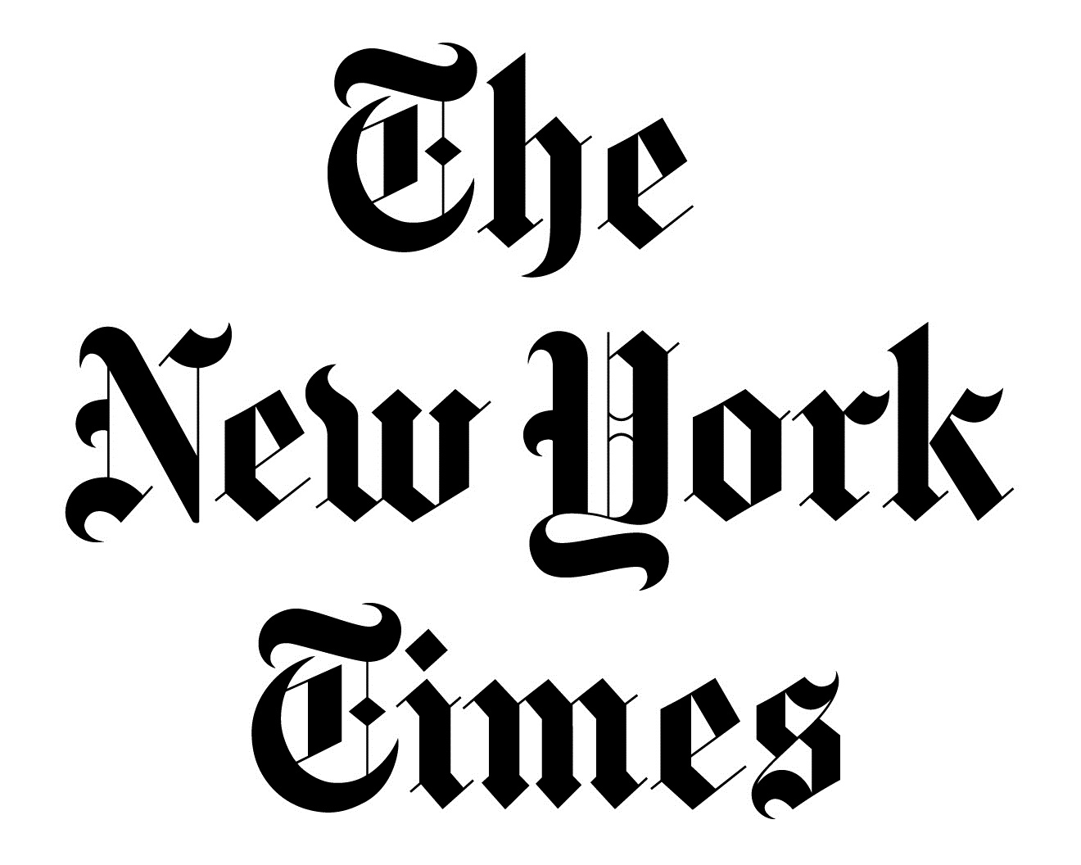





Slide 26

Makes investigations real hard…
VPN Pixel by Google
(Facebook Onavo)
Apple Private Relay
Microsoft Edge Secure Network VPN
“But we aren’t telecommunication companies”
Notes:
https://store.google.com/intl/en/ideas/articles/pixel-vpn/

Slide 27

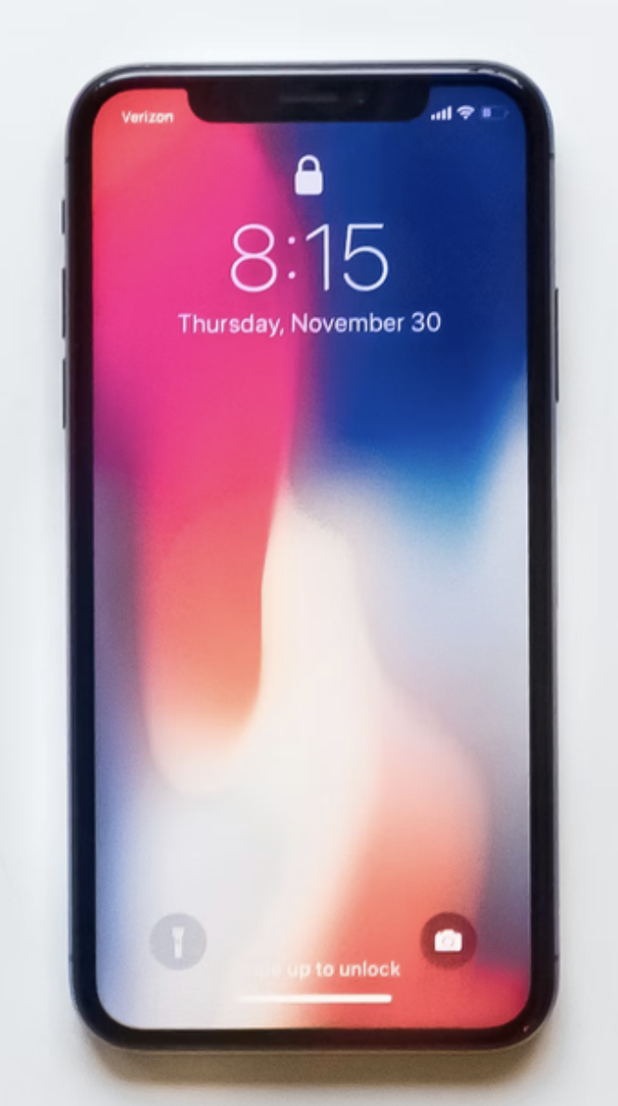
End to end Encrypted
Double ratchet, super nice!
Notes:
This is what we are all talking about in effect. We can’t intercept WhatsApp here in Europe, because it is (supposedly) end to end encrypted

Slide 28



Cleartext backups!
Cleartext backups!
End to end Encrypted
Notes:
Both iphones and android phones URGE you to turn on backups for your most secret communications. Both dissuade you from turning on encrypted backups.

Slide 29
Commercial surveillance
“We’re lovin’ it”
The bulk of websites and apps snitch on everyone all the time

Slide 30
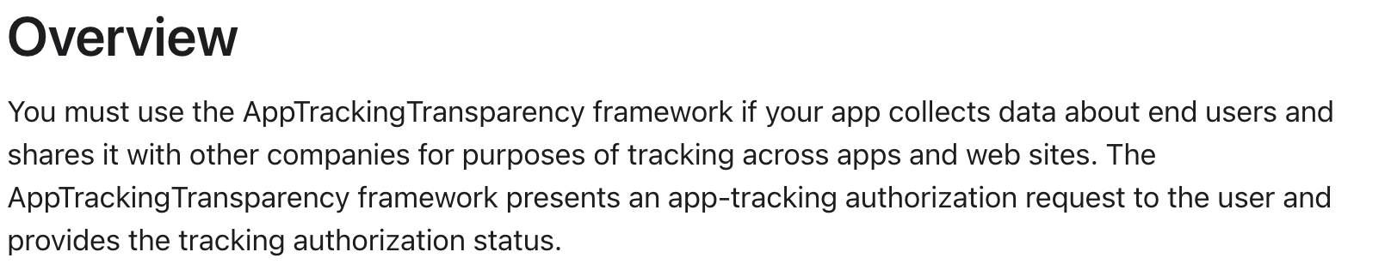
(“ATT”)

Slide 31
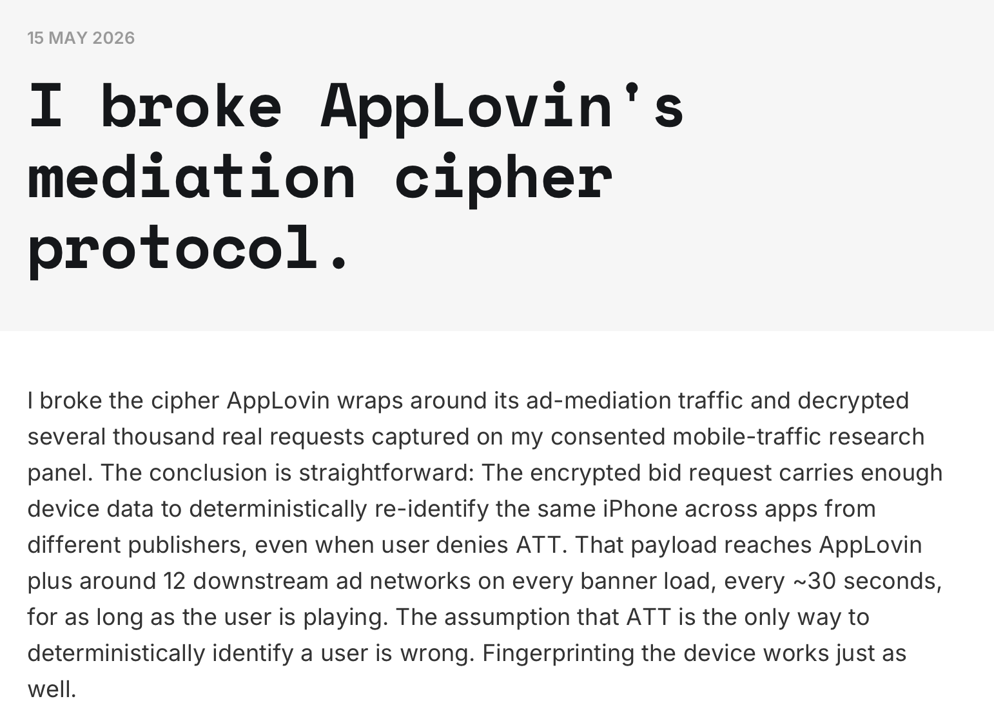
Notes:
https://www.buchodi.com/i-broke-applovins-mediation-cipher-protocol/

Slide 32
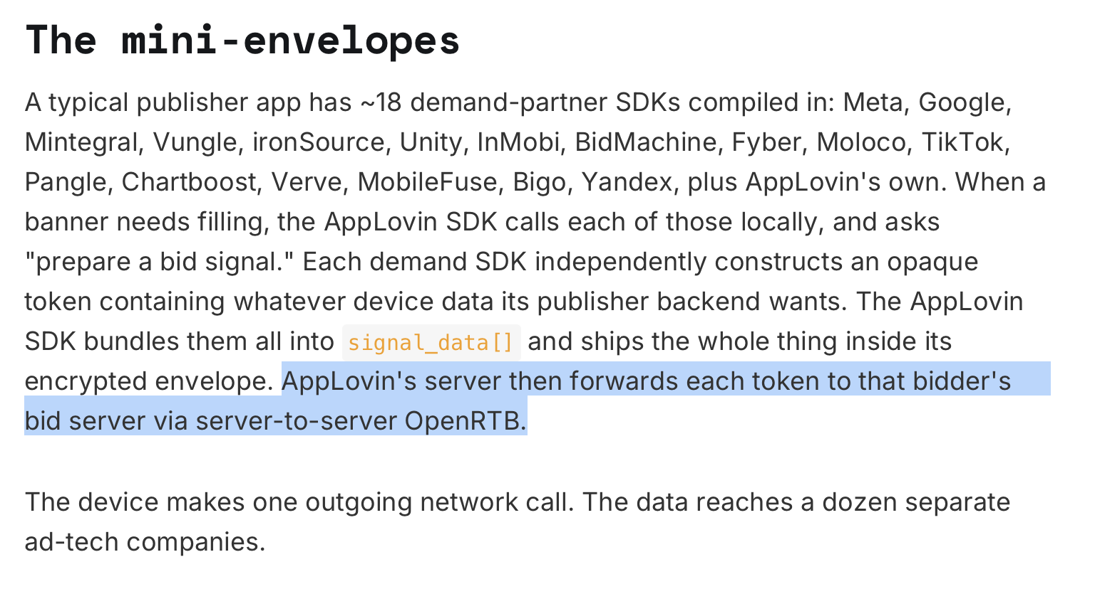
Is it encrypted? And well?
The OpenRTB spec still "recommends" against use of HTTPS (2.2 Security)
Notes:
https://blog.bidswitch.com/openrtb-3.0-what-is-it-and-why-is-almost-nobody-using-it-yet

Slide 33
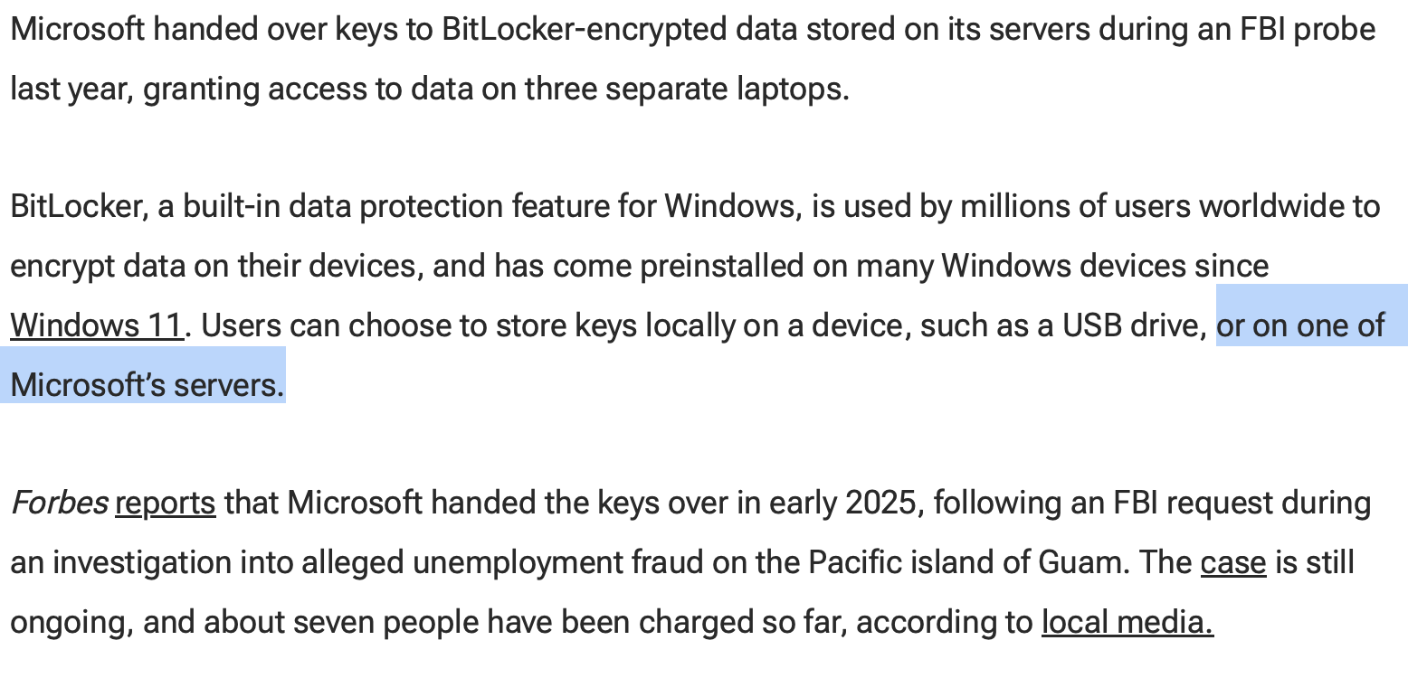
Notes:
https://www.pcmag.com/news/report-microsoft-hands-over-keys-for-bitlocker-encrypted-data-to-fbi

Slide 34
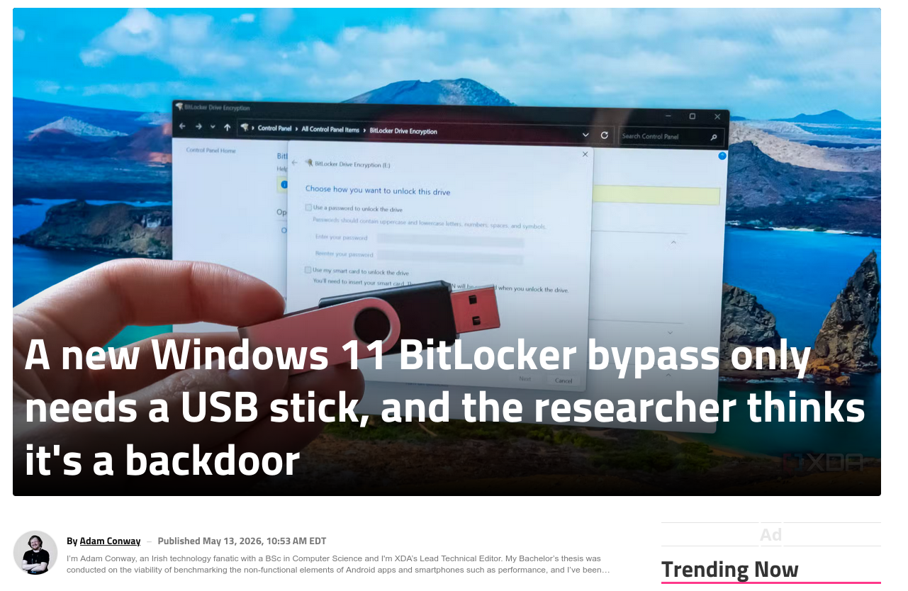
Notes:
https://www.xda-developers.com/new-windows-11-bitlocker-bypass-needs-usb-stick-researcher-backdoor/

Slide 35
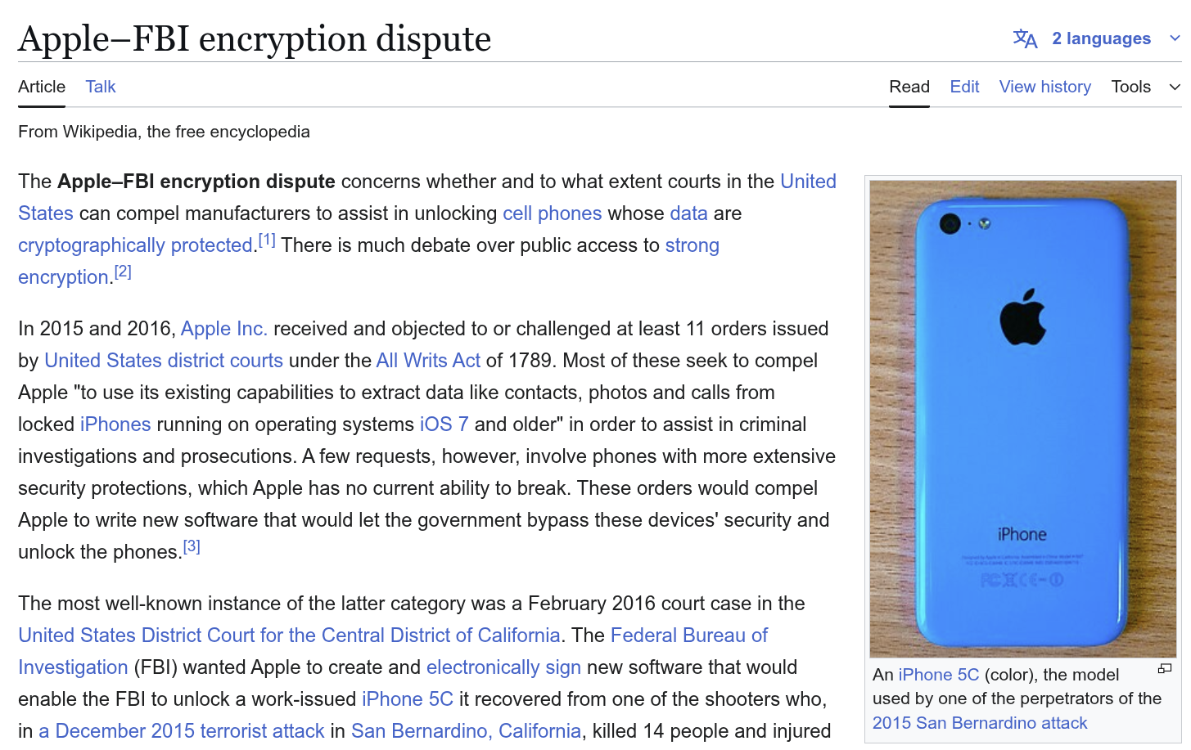

Slide 36
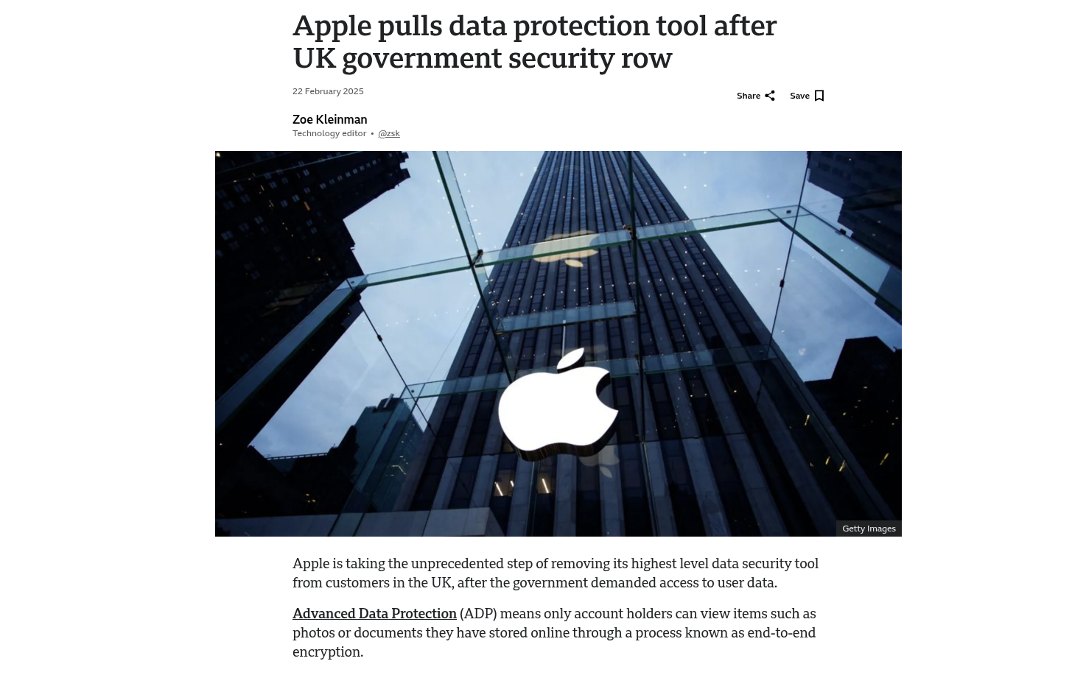

Slide 37

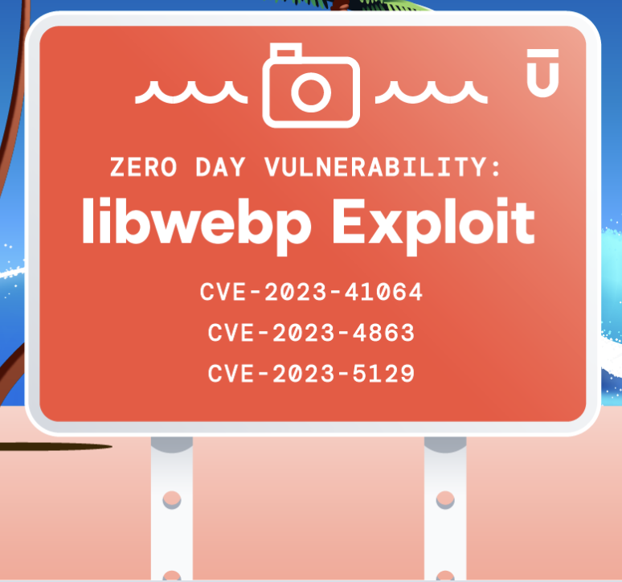
Why did Apple continue to do zero-click display of images and PDFs from untrusted sources? Including a whole font rendering language?
Outside the sandbox?
Notes:
https://www.upwind.io/feed/webp-zero-day-everything-you-need-to-know-about-libwebp
https://projectzero.google/2021/12/a-deep-dive-into-nso-zero-click.html

Slide 38
“The stalemate”
(maintaining US access to most data)

Slide 39
Why do we allow this to happen?
Historical Reasons, not just laziness

Slide 40
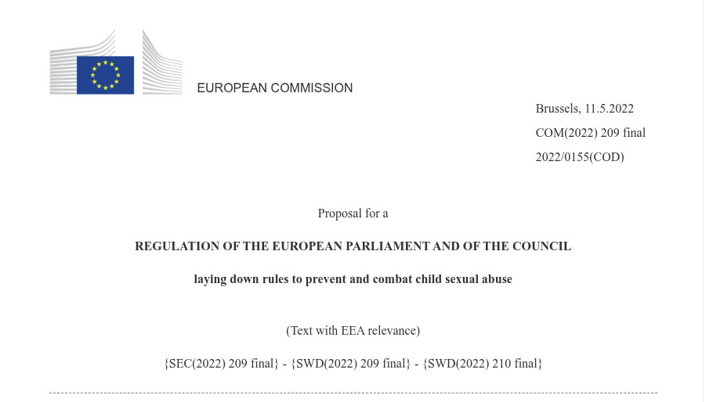

“Get Meta to scan Europe’s deepest secrets & report us to local police. SOME politicians & government people get an exemption”

Slide 41
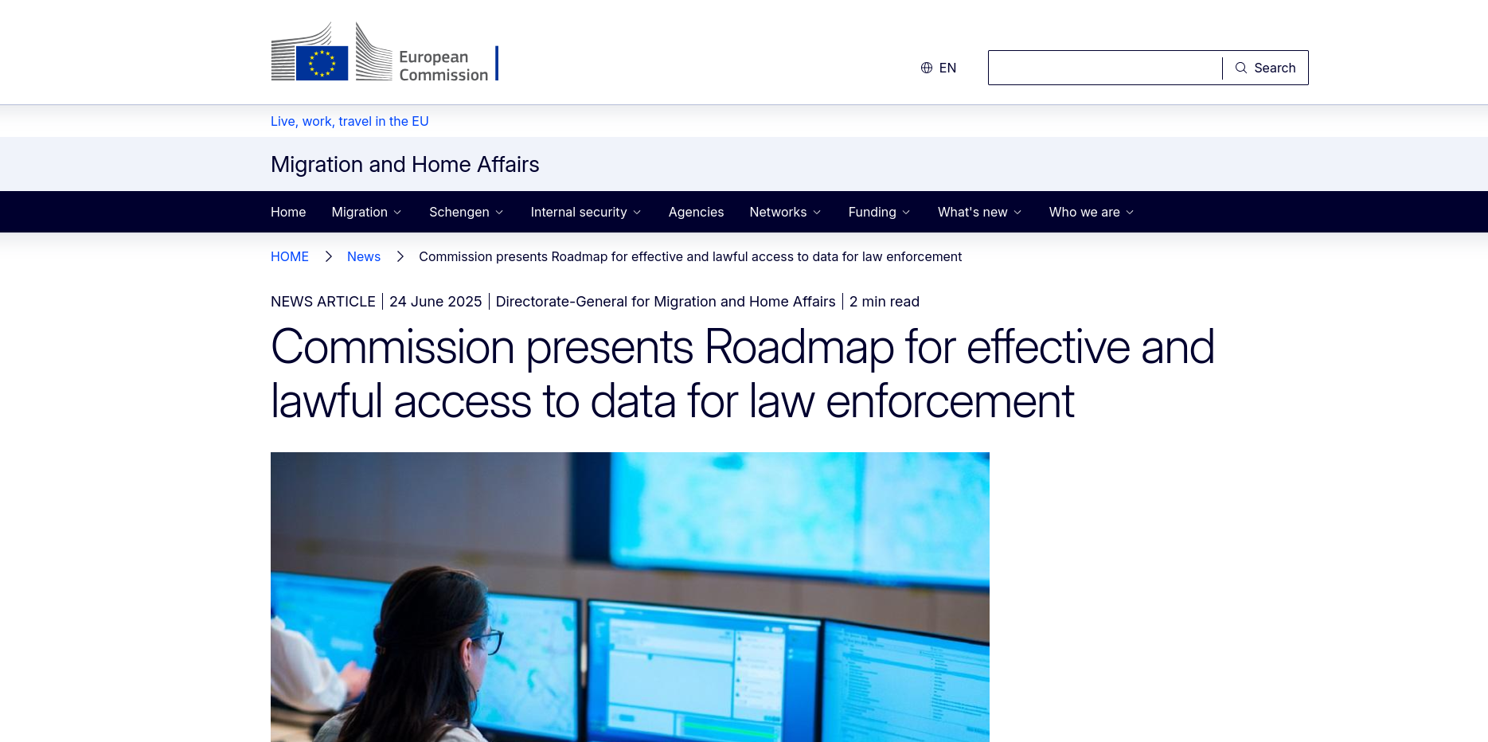

Slide 42
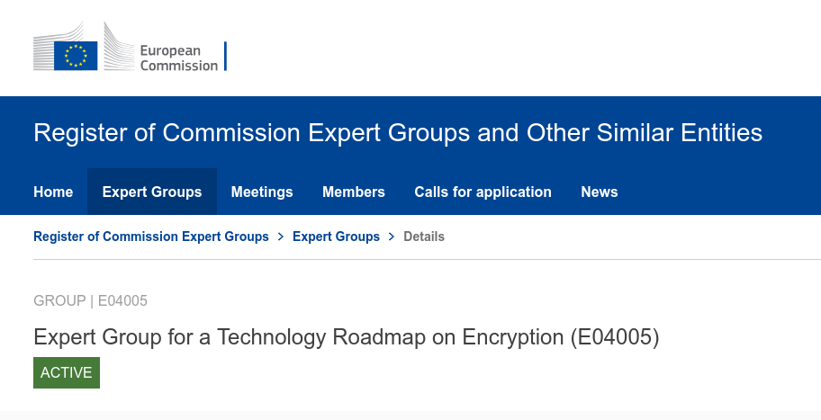

Slide 43
The US has ample access to “encrypted” data. They do not have our problem. They could already help us also. They have data on all Europeans

Slide 44
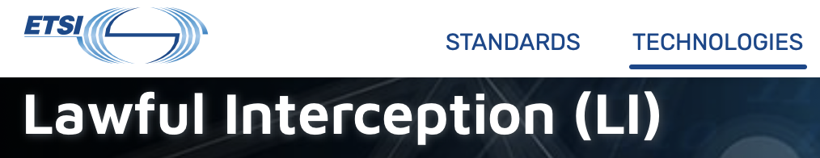
It is theoretically possible to standardize and legislate access to supposedly end-to-end encrypted data.
However, will take >5 years of transatlantic cooperative standard setting and political negotiations

Slide 45
But are they any good at it in the US?

Slide 46
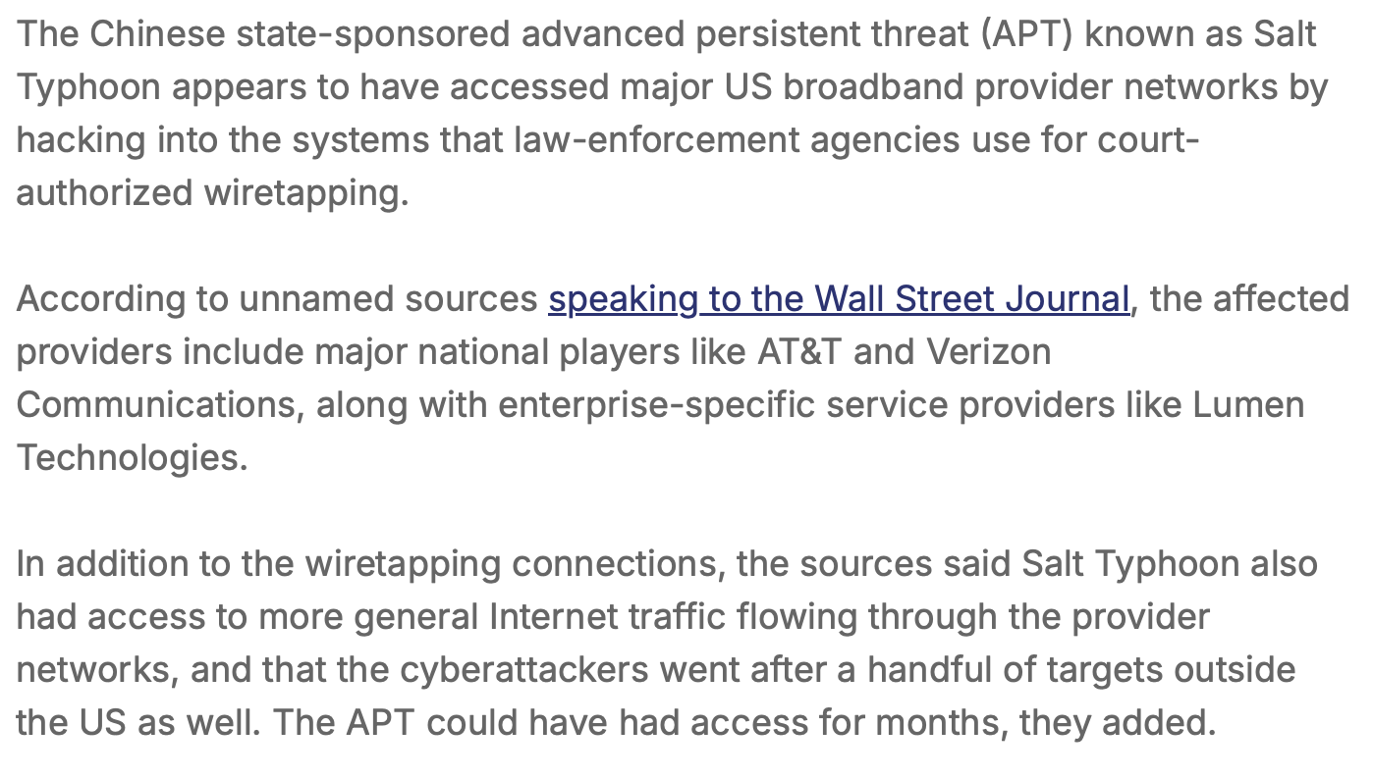

Slide 47
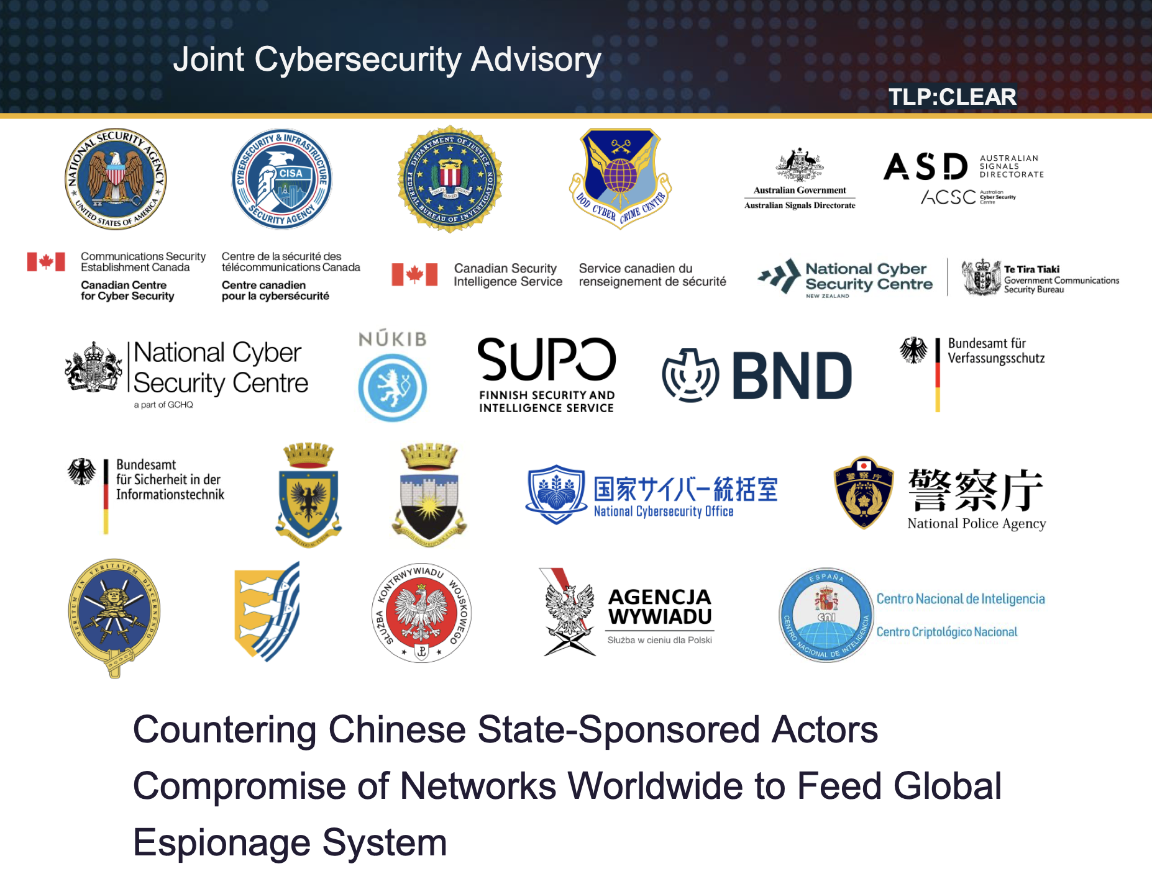
“Salt Typhoon”
Notes:
https://media.defense.gov/2025/Aug/22/2003786665/-1/-1/0/CSA_COUNTERING_CHINA_STATE_ACTORS_COMPROMISE_OF_NETWORKS.PDF

Slide 48
DUAL_EC_DRBG & RSA BSAFE was a disgrace

Slide 49
Summarizing
It is effectively impossible for “normals” to communicate/author documents without their data ending up in (effective) plaintext on US controlled servers
  Try it!
This is maintained through an ongoing evolving stalemate between USGOV and large communication providers (Apple, Google, Microsoft, Meta etc)
Encryption is mostly between users and the servers accessible to the US government. Postquantum straight to the NSA!
Advertising networks feed into this network too
US appears however to be that great at execution anymore
EU has some feeble efforts going

Slide 50
Sovereignty & global surveillance
https://berthub.eu/dis

