Slide 1
THE APPLICATION OF THE NEW EU ECONOMIC GOVERNANCE
Italy’s economic-fiscal situation and its Medium-Term Fiscal-Structural Plan
Hearing before the Finance Committee of the Tweede Kamer, the House of Representatives of the Netherlands
18 December 2024

Slide 2
Italy’s economic-fiscal situation and its fiscal-structural plan
OUTLINE
FRAMING THE FRAMEWORK: Does the reformed fiscal framework deliver on its intended purpose in the case of Italy?
TWO ELEPHANTS IN THE ROOM: NGEU-RRF spending and the Superbonus have blurred the picture for growth and public accounts.
THE PUZZLE OF GROWTH: Why has Italy’s GDP overperformed the rest of the Eurozone since the pandemic? Where is potential?
THE BOOST IN REVENUES: Why have fiscal revenues done so well, and is it now over? Difficult to improve further.
THE CHALLENGE OF REDUCING EXPENDITURES: Will the reduction in spending continue? Is the 1.5% net expenditure path sustainable?

Slide 3
Does the reformed SGP deliver on its intended purpose?
FRAMING THE FRAMEWORK
It is more complex (DSA, technicalities). Yet, it is backed by more economically sound principles. Reduced incentives to game the rules.
It allows for a realistic and gradual fiscal adjustment. 1.0pp reduction in the debt ratio only after the initial adjustment period, i.e. 2028.
There is no longer a gap between public finance rules and the long-term demographic and ageing projections. Important for Italy.
Fiscal plans come together with reforms and public investment.
On paper, less pro-cyclicality. We will see if it works operationally.
A longer planning horizon is crucial for Italy, forcing broader debate.
It better clarifies the baseline projection: Italy’s current legislation vs unchanged policy. Ownership is key for domestic politics.
Need for greater harmonisation of various publications.

Slide 4
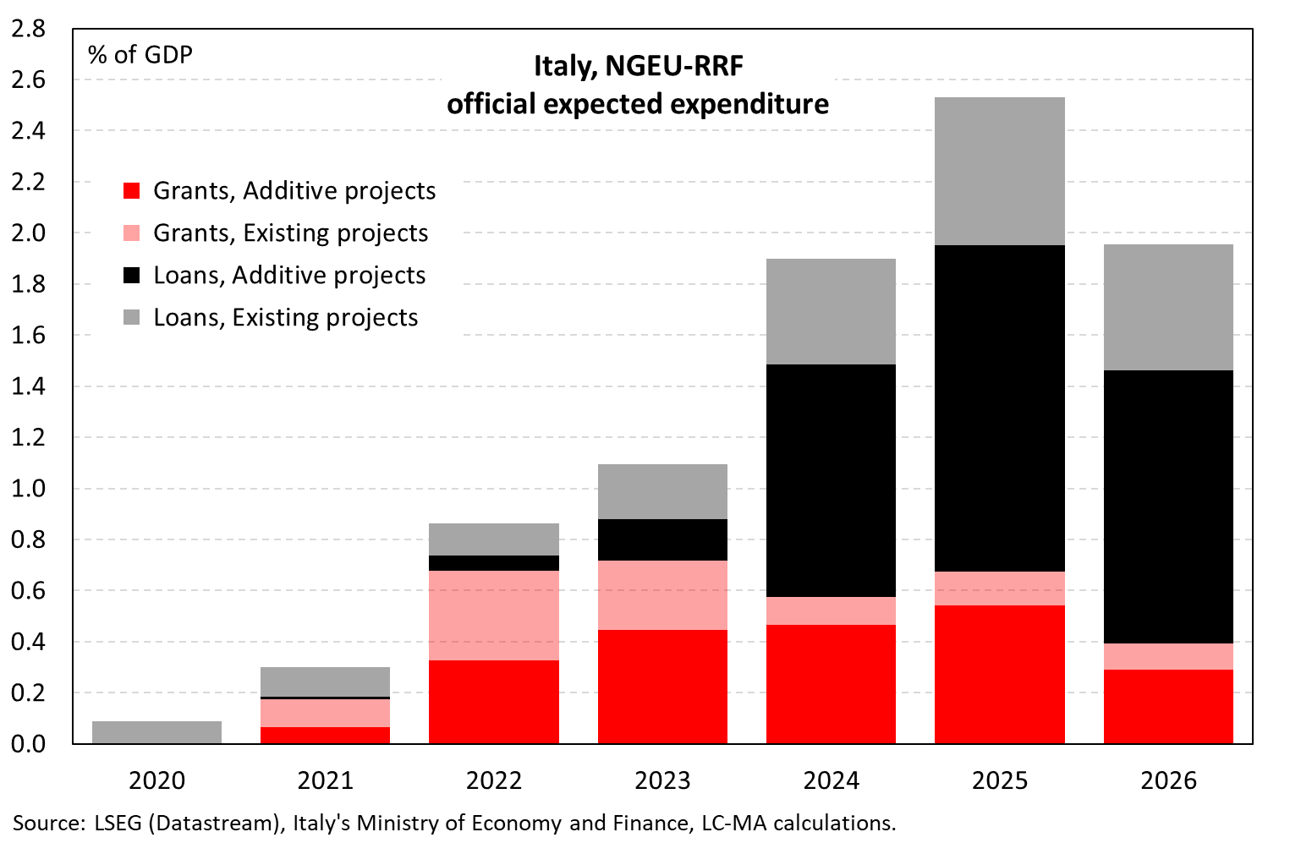
Lower additive spending? Delays? Less underlying growth?
TWO ELEPHANTS IN THE ROOM
4

Slide 5
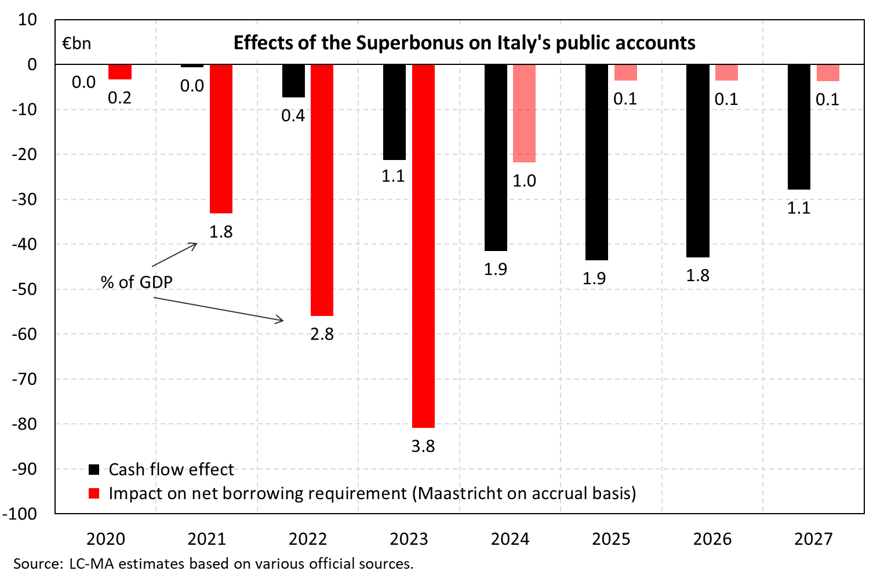
Cash/accrual flow estimates related to the Superbonus
TWO ELEPHANTS IN THE ROOM
5

Slide 6
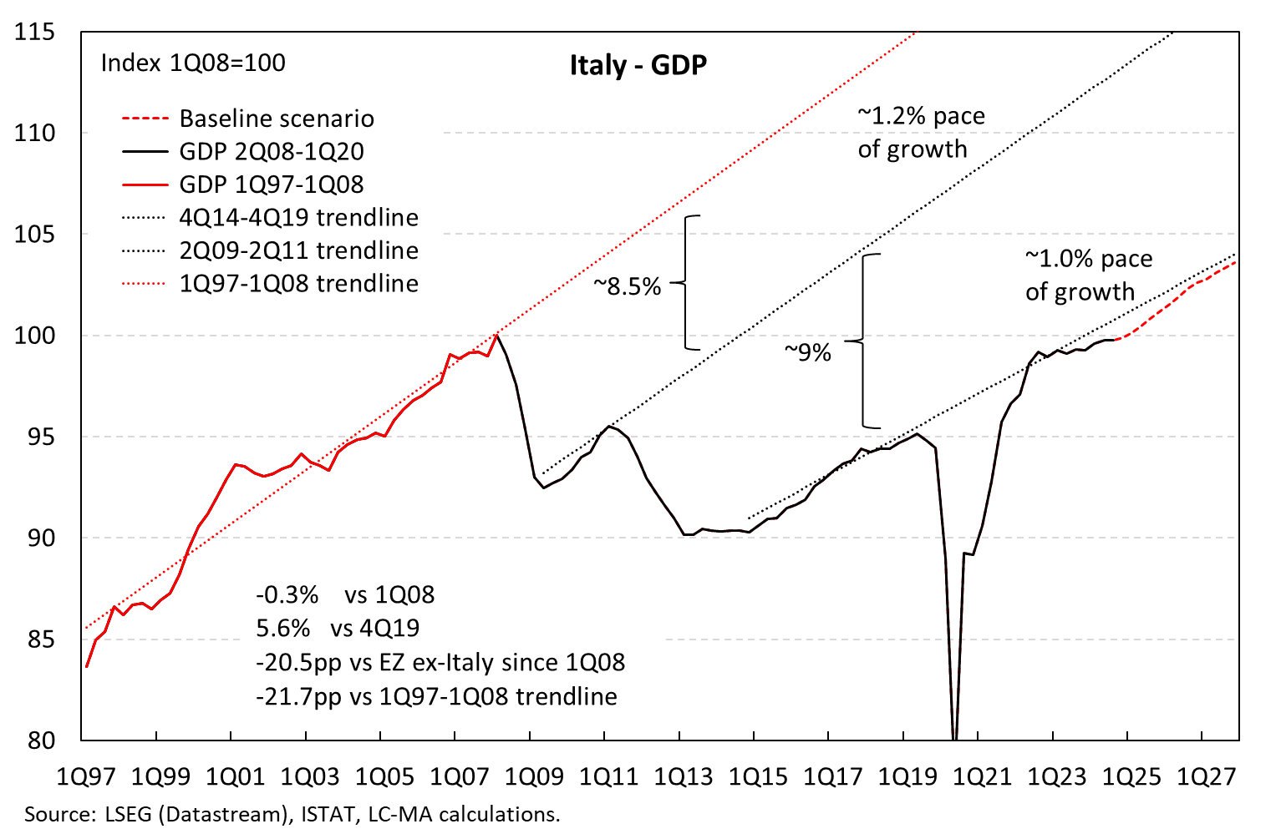
Little hysteresis. How much was due to demand stimulus?
THE PUZZLE OF GROWTH
6

Slide 7
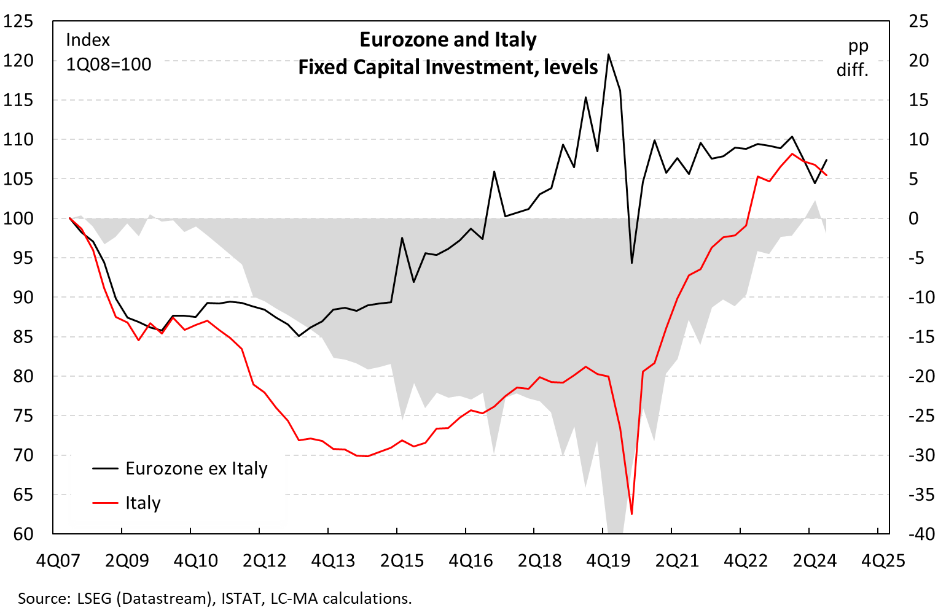
The gap in fixed capital investment has closed
THE PUZZLE OF GROWTH
7

Slide 8
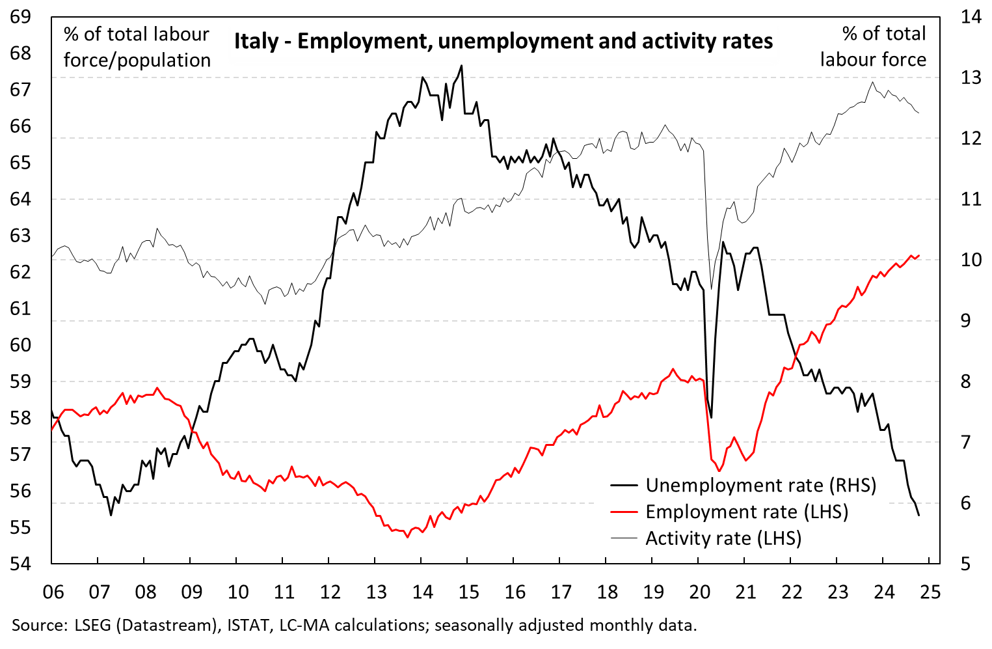
A job-rich recovery: A big positive development
THE PUZZLE OF GROWTH
8

Slide 9
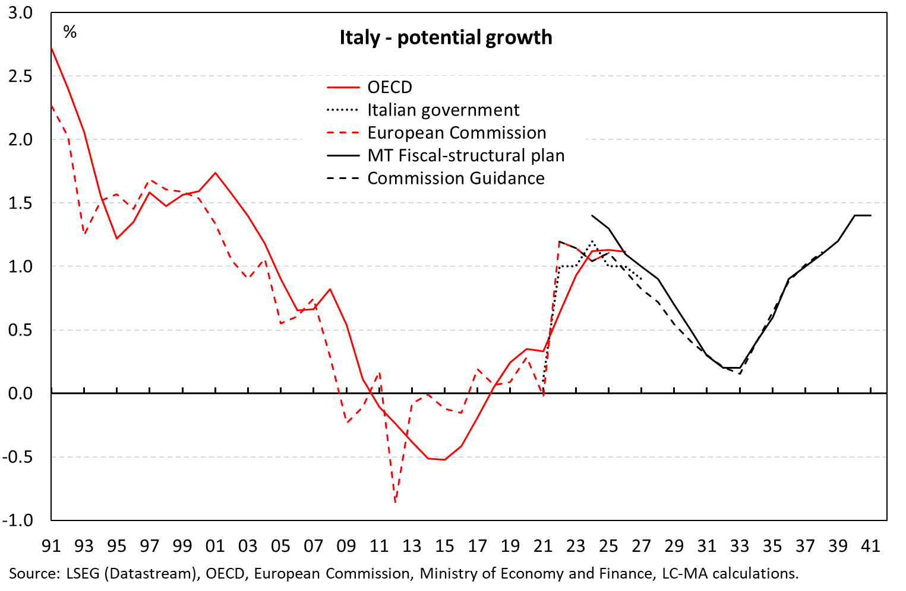
Prudent assumption on potential growth, or too prudent?
THE PUZZLE OF GROWTH
9

Slide 10
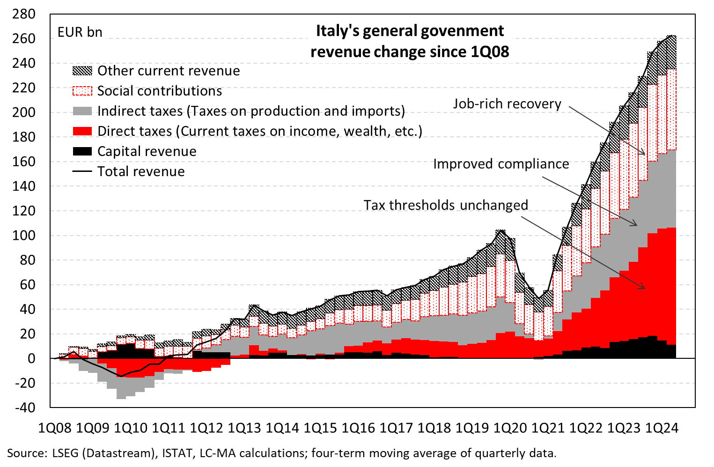
The strong rise in revenue can be explained
THE BOOST IN REVENUES

Slide 11
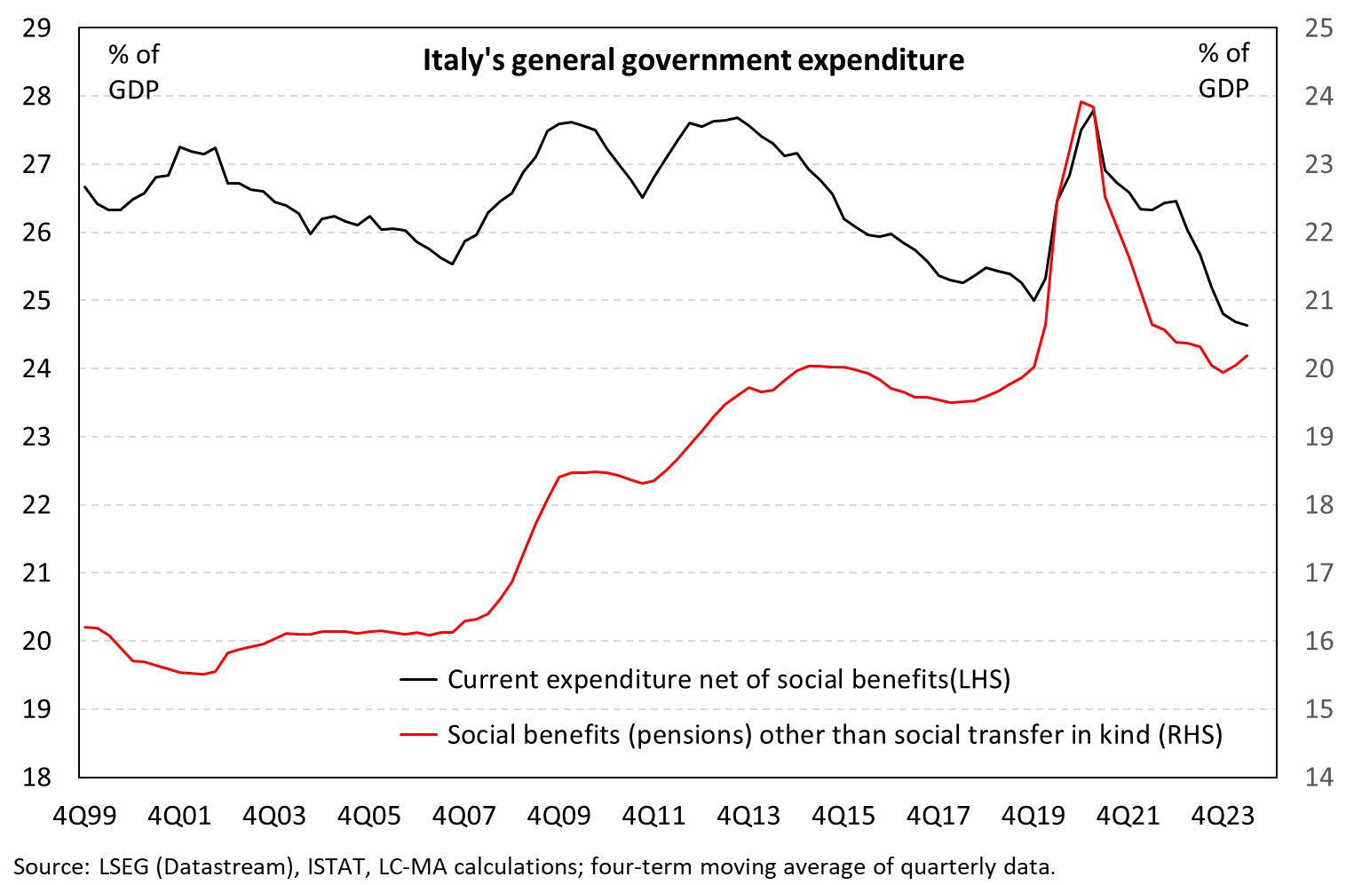
Expenditure could not catch up with higher inflation
THE CHALLENGE OF REDUCING EXPENDITURE

Slide 12
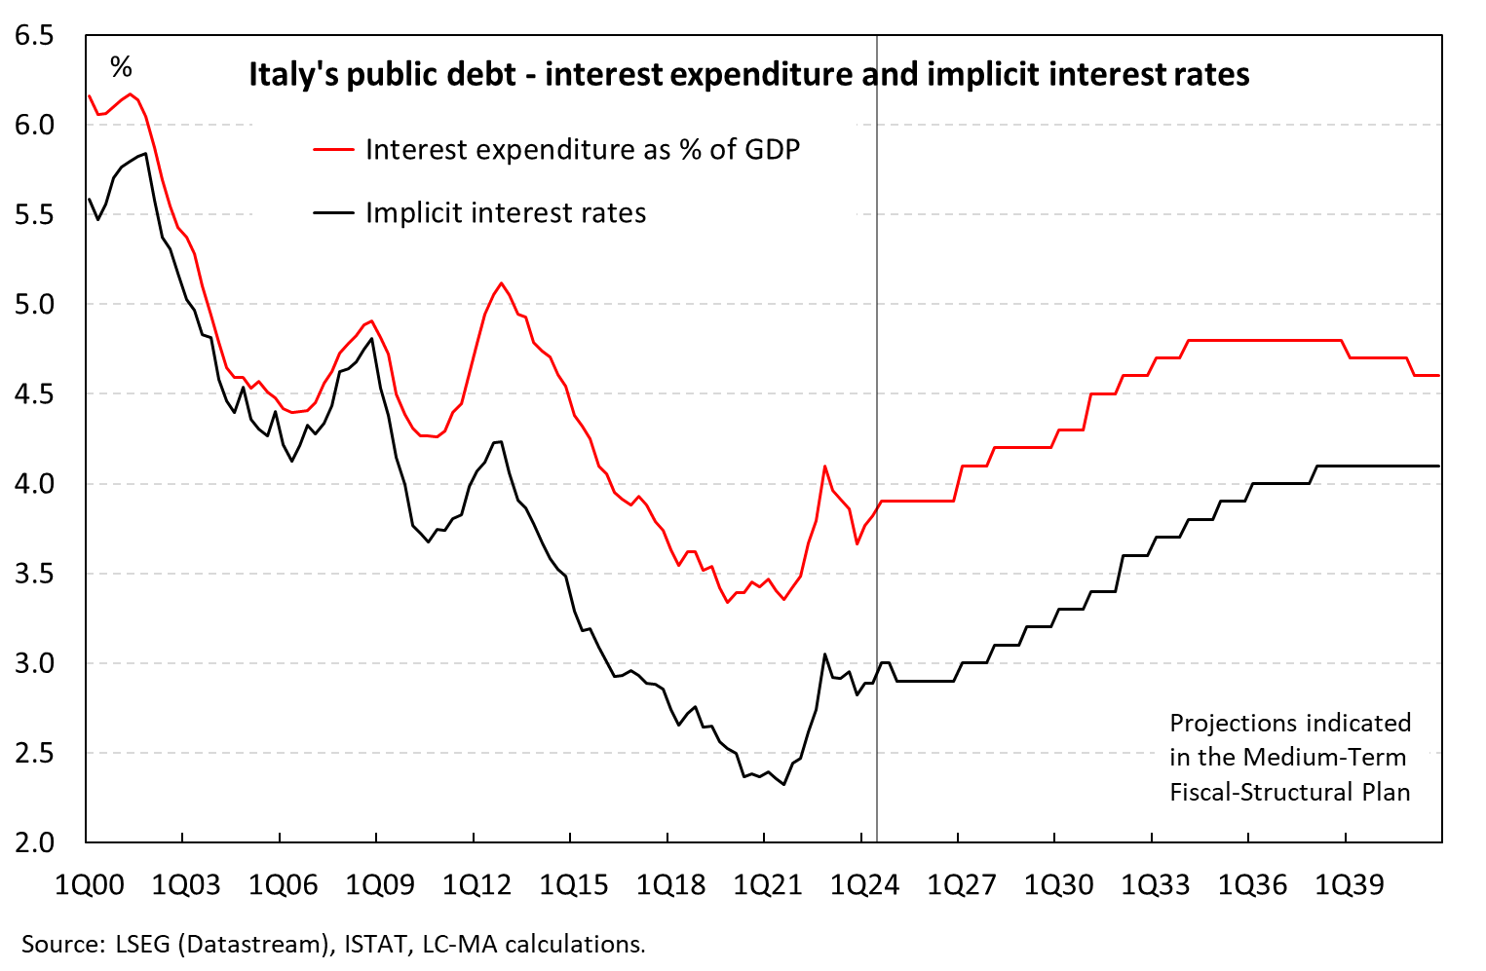
Interest expenditure may turn out lower than projected
THE CHALLENGE OF REDUCING EXPENDITURE

Slide 13
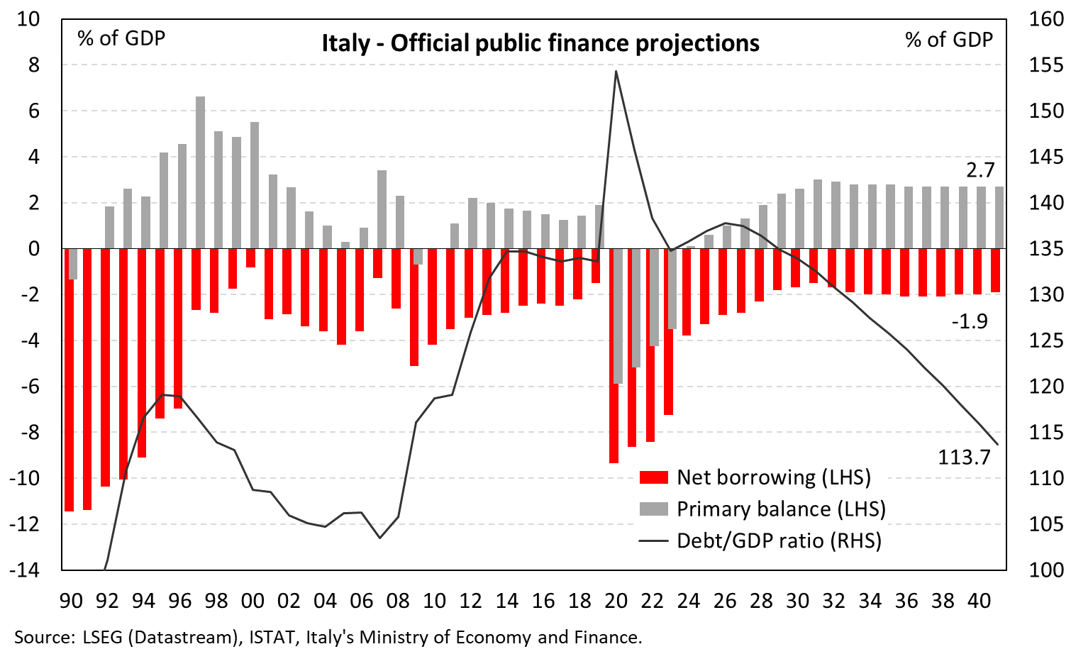
Feasible, prudent. Yet, vulnerable to shocks & challenging cuts
CONCLUSION

